Slide 1
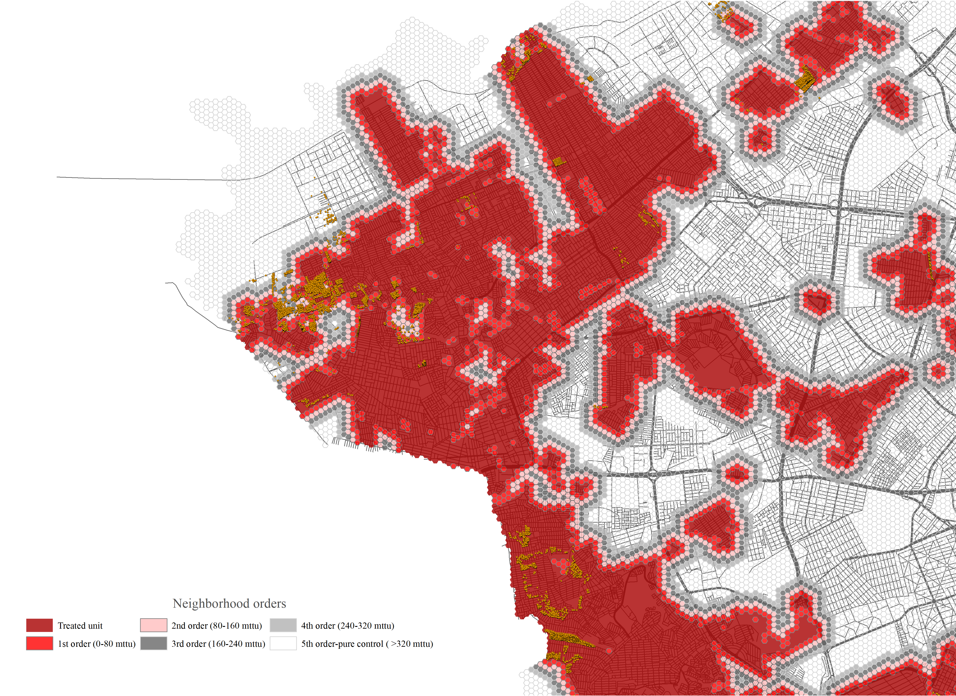
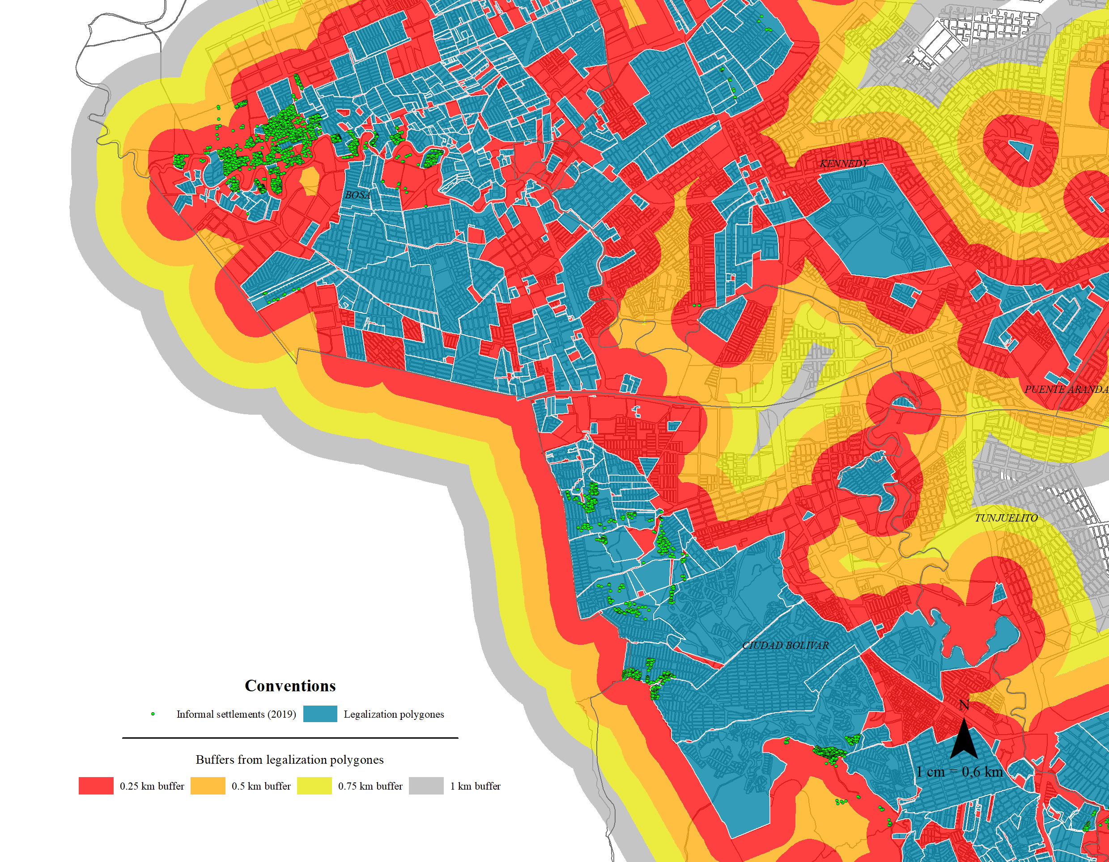


Slum recognition effects on urban informal expansion:
An impact evaluation of the Neighborhood Legalization program in Bogotá, Colombia
Universidad del Rosario, 2022
Faculty of Economics
Guibor Camargo
https://github.com/Guibi1994/Neighborhood_Legalization

Slide 2
Slum recognition effects on urban informal expansion:
An impact evaluation of the Neighborhood Legalization program in Bogotá, Colombia
Universidad del Rosario, 2022
Faculty of Economics
Guibor Camargo
https://github.com/Guibi1994/Neighborhood_Legalization

Slide 3
Introduction
Context:
Urban expansion is one of the most important events in South America’s recent history.
In the las three decades Bogotá almost doubled (DANE,1989,2005 and 2018), and up today is the 46th most dense urban area in the world
Habitat challenges: 3.8% of Bogota’s household are in quantitative deficit while 10.2% are in qualitative deficit (DANE 2018).
Universidad del Rosario - Faculty of Economics
Guibor Camargo

Slide 4
Introduction
Policy response:
Law 388 of 1994 (Birth of the POTs – [Es] Planes de Ordenamiento Terrotiral): Urban plans which, through programs and norms, seek to order and re-direct formal and informal urban growth.
To deal with slum’s expansion, the POTs integrated the neighborhood legalization program: recognizing illegal settlements, so they can be letter could later be provided with public infrastructure and amenities.
.Informal Settlement (construction type/origin) ≠ Illegal Settlements (legal status)
Universidad del Rosario - Faculty of Economics
Guibor Camargo

Slide 5
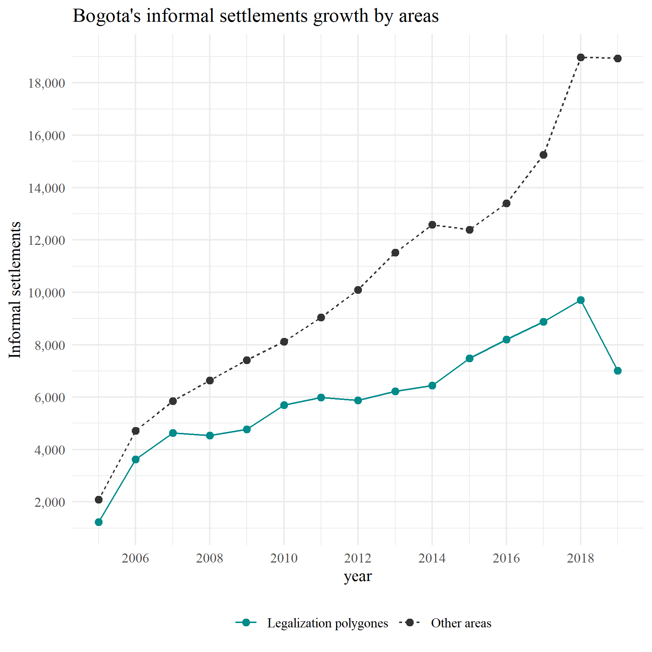
Introduction
Politicians and governments have advocated for stopping the legalization program (as well as other slum improvement-oriented policies) based on the belief that neighborhood legalization program could foster or incentive illegal and informal growth.
This vision has gained support from construction companies which build new social housing projects.
On the other hand, other have claim that this kind of program not only do not foster informal expansion but also represent a cheaper solution to the habitat problem both for the government and low-income families.
A quick first look at the data shows that the legalization of polygons seems to have had a lower informal expansion rate than the rest of the city.
Universidad del Rosario - Faculty of Economics
Guibor Camargo

Slide 6
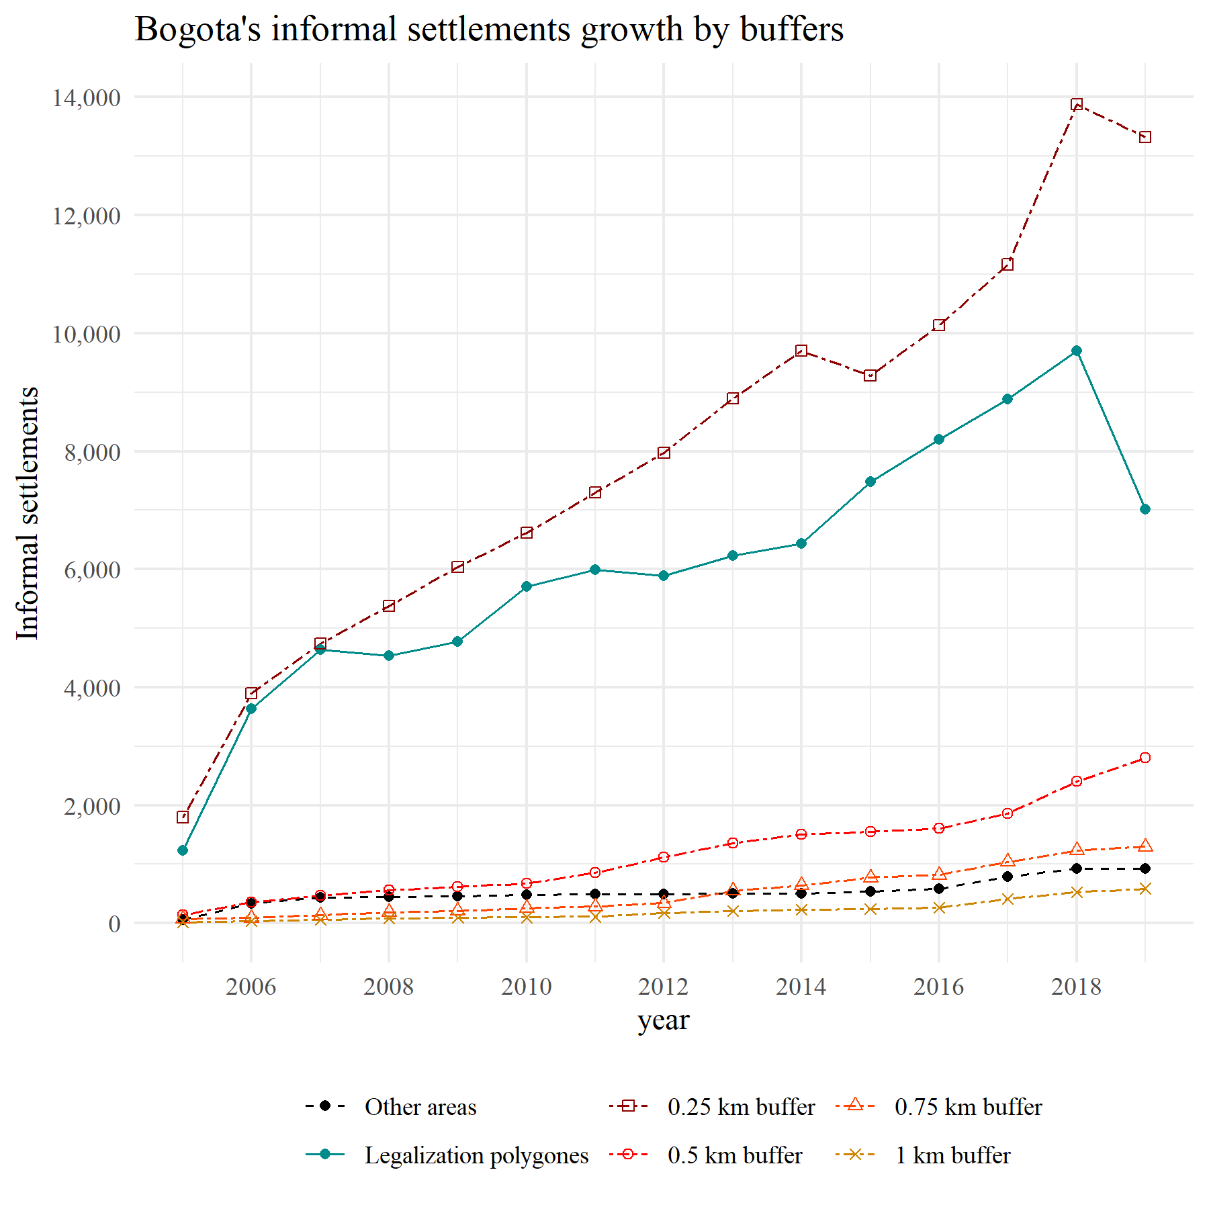
Introduction
Nevertheless, if one observes closer, it seems that the areas closer to the legalization of polygons are the ones that have experienced the faster informal occupation expansion in the last 15 years.
The research question then is ¿Have the neighborhood legalization program incentivized urban illegal expansion?
H0 = Yes but depending on the intervention’s geographic and economic context
Universidad del Rosario - Faculty of Economics
Guibor Camargo

Slide 7
Introduction
Slum intervention’s effects:
Effects over public health: Bhan, N. (2013) ; Pérez-Casas, M. (2017); Henson, R. M., et al. (2020);
Effects over household economy and unemployment: Amis, P. (2001); Takeuchi, A., Cropper, M., & Bento, A. (2008)*; Majale, M. (2008); Olthuis, K., Benni, et al. (2015); Bardhan, R.,et al. (2015)
Effects over land prices and construction: Nieto, C. A. B., et al (2017); Corredor Collazos, M. E. (2020)**.
Scientific gaps and opportunities:
Most of studies focus on physical interventions rather than legal actions.
The majority focus on positive outcomes (sometimes determinists ones), ignoring policies side effects.
Most oversimplify the policies, making risky assumptions that put in doubt causal claims.
Almost no study analyses effect heterogeneity and it’s sources
Still, impact evaluations on slum management still scarce.
Universidad del Rosario - Faculty of Economics
Guibor Camargo

Slide 8






Data
Neighborhood Legalization polygons with legal process info* (1950-2019)
Neighborhood Improvement program polygons* (2002-2019)
Resettlement Program points (2004-2019)
Informal constructions –SDH (2005-2019)
Formal constructions – ODC (2012-2019)
Census data (2005 and 2018)
Universidad del Rosario - Faculty of Economics
Guibor Camargo

Slide 9
Context

Slide 10
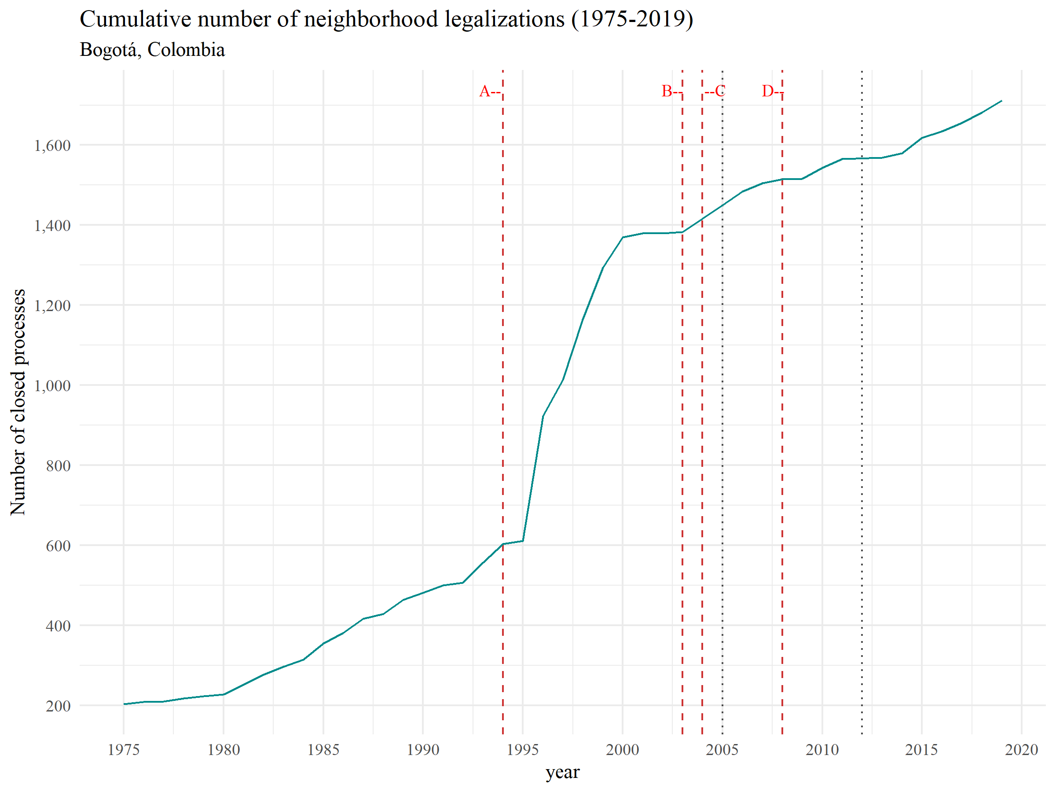
Political context: fighting informally or denying it?
Historical milestones:
.1994: The Law 388 gave to all municipalities the order to formulate their first POT’s.
.2003: President Alvaro Uribe Velez stablished in his Developing Plan that informal settlements which origin year were after 2003, could not be legalized nor receive any public investment. (VIS/VIP/Macro)
.2004: Bogotá finally (by decree) adopts its first POT (decree 190 of 2004).
.2008: The constitutional court declare the 2003 restriction against the constitution.
Universidad del Rosario - Faculty of Economics
Guibor Camargo

Slide 11
Context: articulation with other programs
New social housing programs
yes
Resettlement program (●)
no
“It’s on high-risk zones □?”
no
Neighborhood legalization program (□)
Lawsuit - “Tutela”
Illegal connections
“Is the settlement legal?”
District office of Habitat titling programs (●)
Public services
(aqueduct, sewerage, electricity, etc.)
“Does the settlement have available space for public infrastructure?”
Property Titling
yes
no
yes
Neighborhood improvement program – MIB (□)
Public infrastructure
(roads, parks, schools, etc.)
Regularization program (□)
Universidad del Rosario - Faculty of Economics
Guibor Camargo

Slide 12
Methodology

Slide 13
Methodology: empirical challenges
- Challenge #1: Unit of treatment’s heterogenous geography
- Challenge #2: Spatial spill-overs (violations of SUTVA)
- Challenge #3: Some outcomes are observed just in restricted areas
- Challenge #4: Relevant differences across units
Differences in the relation with historical programs or interventions:
Differences exposure to current regulatory framework
Differences in demographic composition
- Challenge #5: External chocks (court intervention)
- Challenge #6: Absence of “pure never-treated” units and different treatment times
- Challenge #7: Difference in anticipation time
Universidad del Rosario - Faculty of Economics
Guibor Camargo

Slide 14
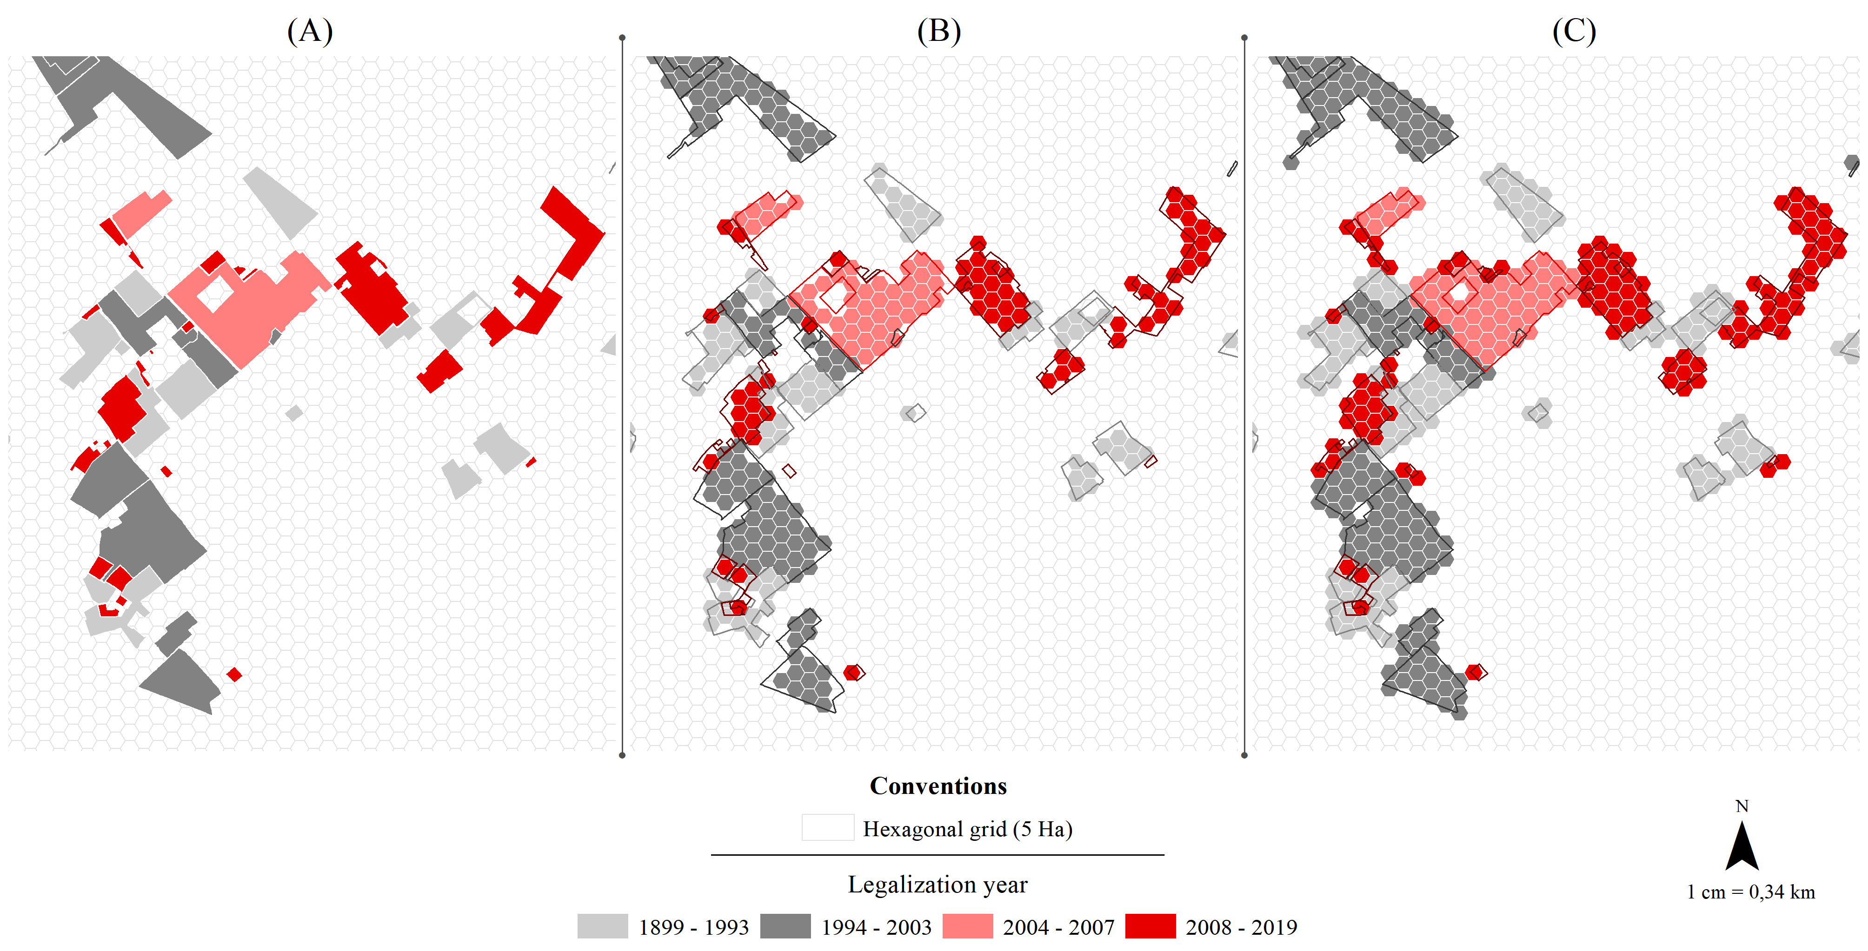
Addressing challenge #1: Unit of treatment’s heterogenous geography
Standardizing unit of analysis
Legalization polygons where transform into hexagons of 5 Ha each.
Treatment and controls are defined by nor by centroid intersection (B) but rather by closest centroid (C), to avoid treated unit’s omission.
By doing this we guarantee:
A geographic standardized unit of analysis.
Representation of all treated areas
Standardization of never-treated units
Universidad del Rosario - Faculty of Economics
Guibor Camargo

Slide 15
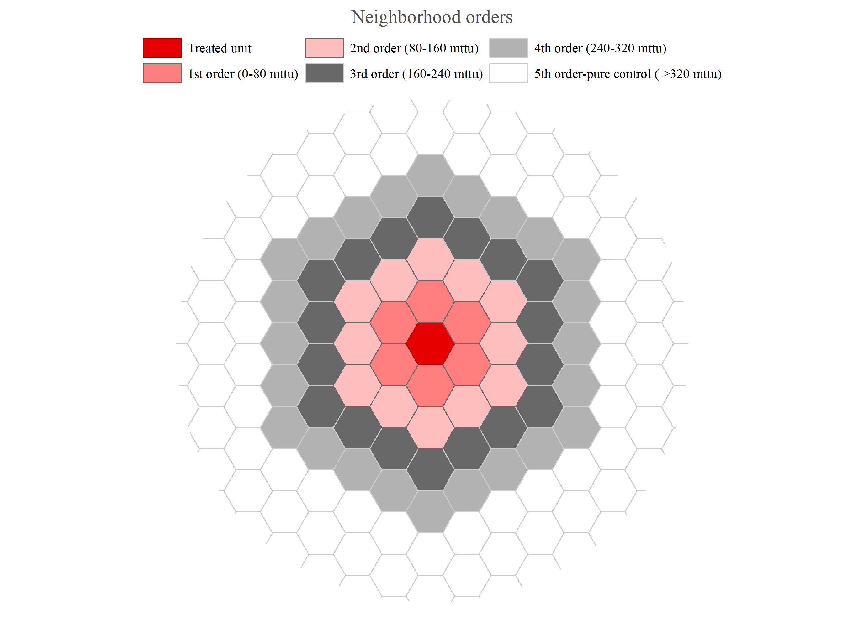

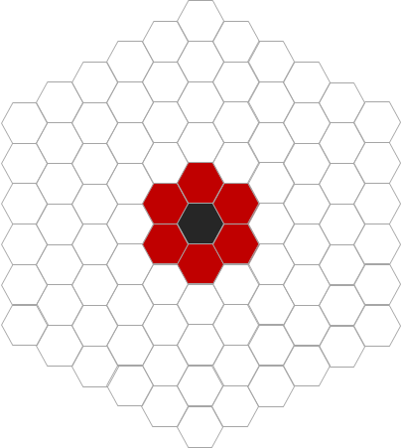



Addressing challenge #2: Spatial spill-overs
(A)
Defining the range of contamination
To deal with possible violation of SUTVA we categorize control units into five neighborhood orders and employed two different strategies:
Controlling comparation’s units: We run the model taking different combinations of neighborhood units.
i.e. Treated VS 1st neighbors || Treated VS 2nd neighbors || … Treated VS all Neighbors.
Measuring spill-over effects: We additionally run several placebos test, assuming neighbor control units to be treatment units instead.
(B)
Placebos’ Structure
Standard model
Placebo #1
Placebo #2
Placebo #3
Placebo #4
Treated units
Control units
Omitted units
Universidad del Rosario - Faculty of Economics
Guibor Camargo

Slide 16
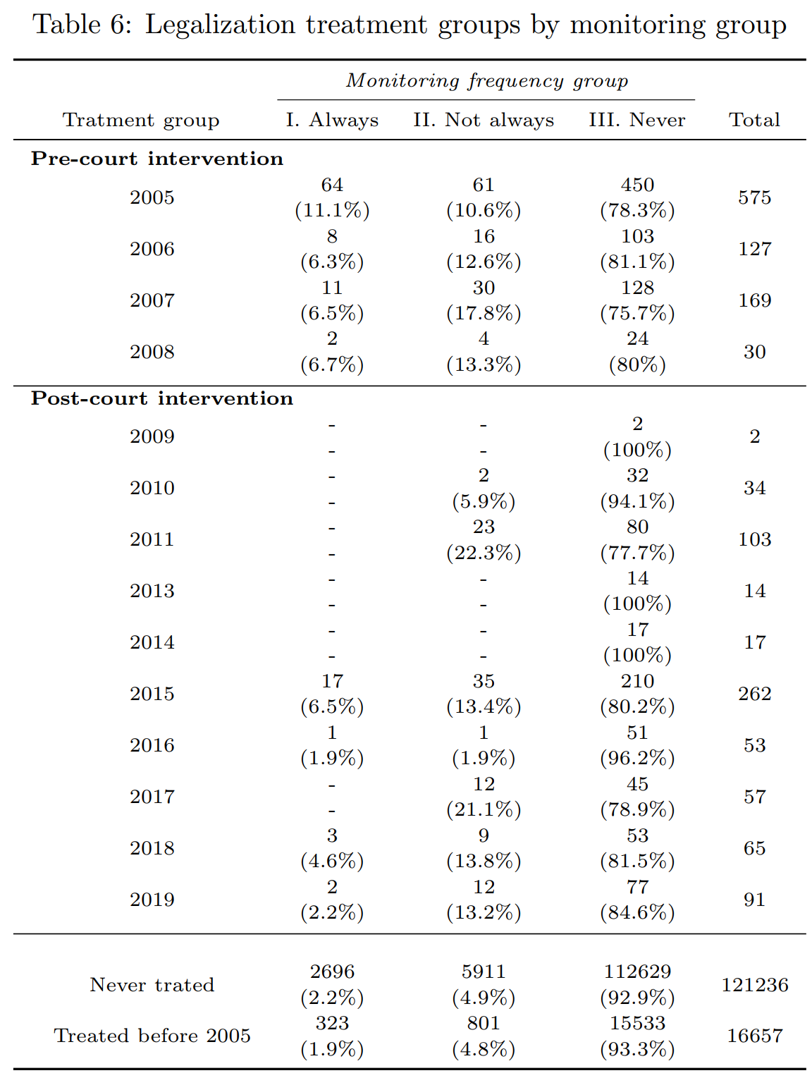
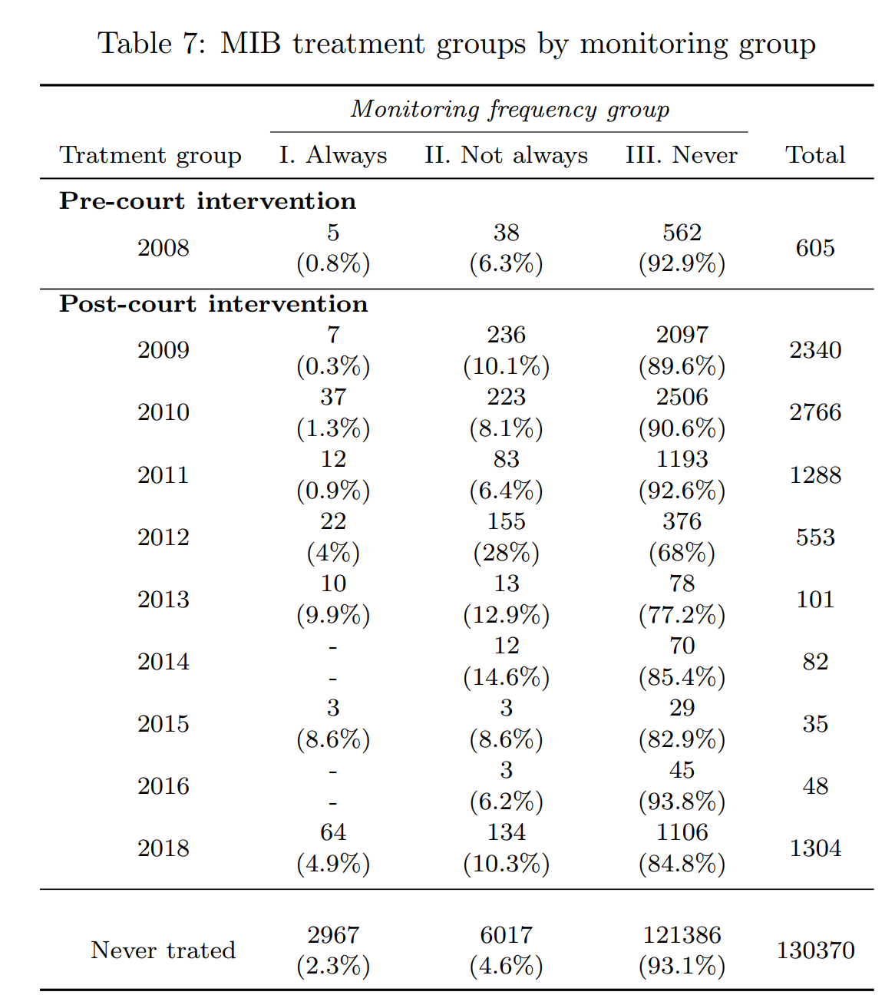
Addressing challenge #3: Restricted observations for key outcomes
Keeping comparability
Considerations:
Our main outcomes are:
Illegal occupations
Evolution of the resettlement program
Formal construction (cadastral bases’ changes)
Illegal occupation are just observed across monitoring polygons which changes over time and do not over all the city’s surface.
Then, just a little portion of tarted units are effectively observed in all periods of time (2005-2019) for this outcome.
Procedure:
For comparability, we ran the analysis with the same restricted sample for the rest of the outcomes. Nevertheless, we also analyze the remaining outcomes with all the data.
Universidad del Rosario - Faculty of Economics
Guibor Camargo

Slide 17
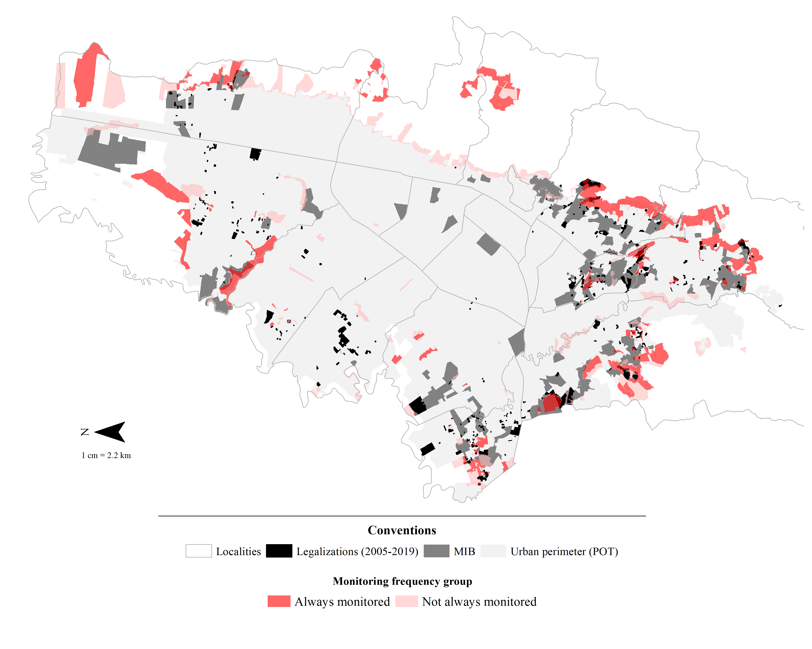
Addressing challenge #3: Restricted observations for key outcomes
Universidad del Rosario - Faculty of Economics
Guibor Camargo

Slide 18
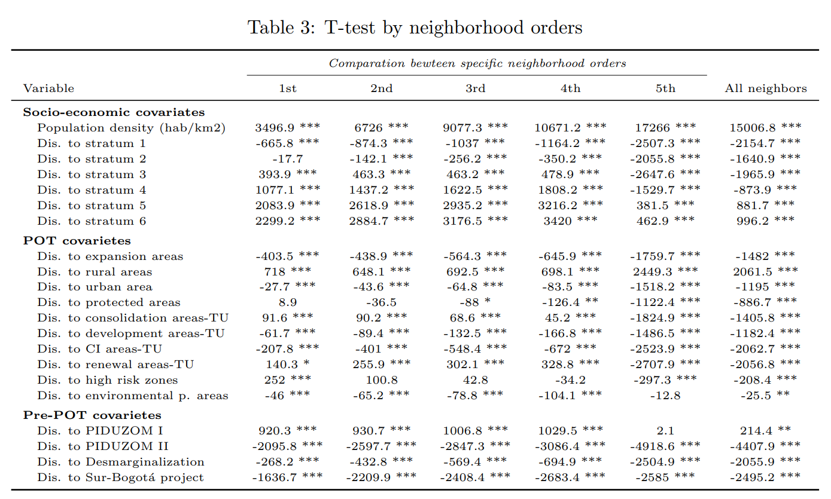
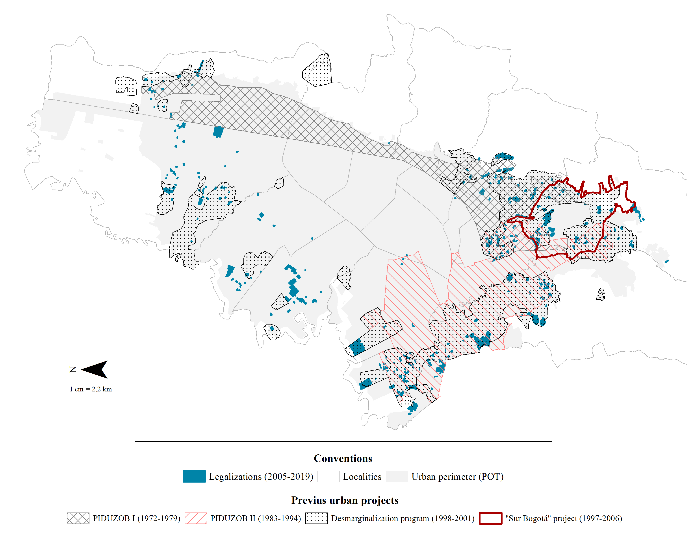
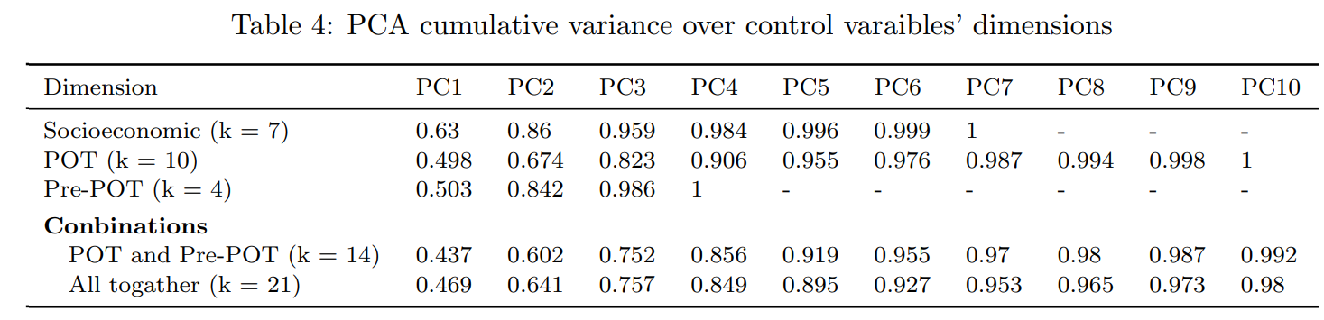
Addressing challenge #4: Differences between units
Selecting and transforming covariates
Considerations:
There are multiple sources of variation, both from current differences and historical dynamics.
However, since the main models’ sample is quite restricted, adding all relevant covaries could represent an important loss of degrees of freedom.
Procedure
We reconstruct the most relevant covariates and perform a PCA analysis to reduce its dimensionality*.
*Note: We observed significant difference between treated units and different sets of control groups, which could represent a relevant endogeneity problem between (i.e.) historical programs and the legalization program. Nevertheless, we argue that (i) historically and institutionally, there is no relation between previous programs and legalization occurred after 2005; (ii) if PT assumption holds, we would still be capturing the program’s causal effects; and (iii) most differences are statistically significant but geographically depreciable (x < 1 km).
Universidad del Rosario - Faculty of Economics
Guibor Camargo

Slide 19
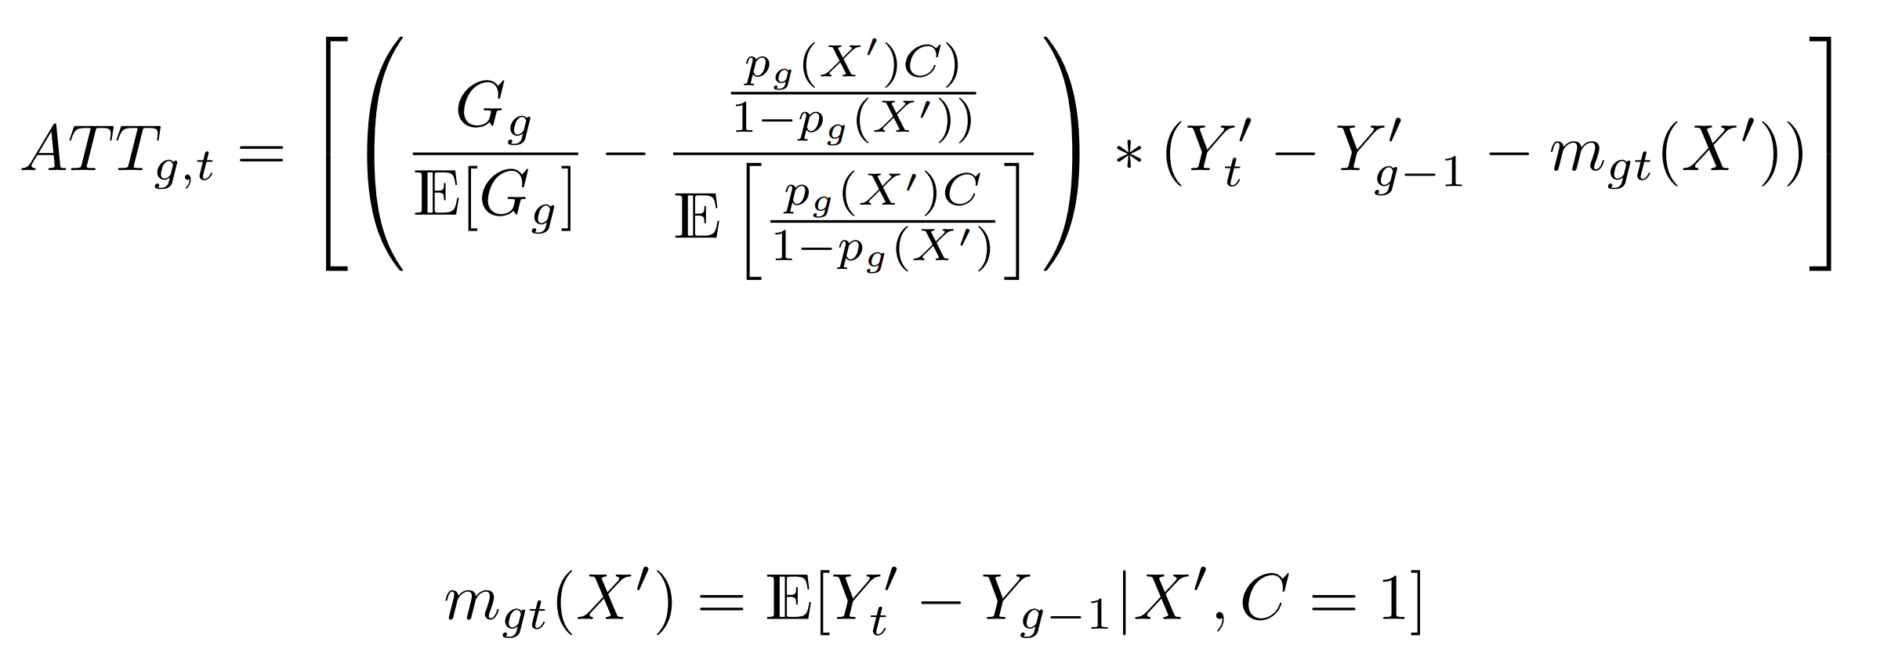
Addressing challenge #5 to #7:Anticipation, treatment timing differences and external chocks.
Estimating DID models base on Callaway and Sant’Anna (2021)
Allow for difference in treatment timing, focusing on not yet tarted units: avoiding forbidden comparation as in the classical two-way fixed effects approach.
The identification of treatment dynamic across time and treatment groups (group effects and event study effects), comes in handy when analyzing externa chocks.
Covariates are integrated indirectly trough PS and or a regression outcome approach, allowing for conditional parallel trends.
The approach also allows to test for policy’s anticipation effects
Universidad del Rosario - Faculty of Economics
Guibor Camargo

Slide 20
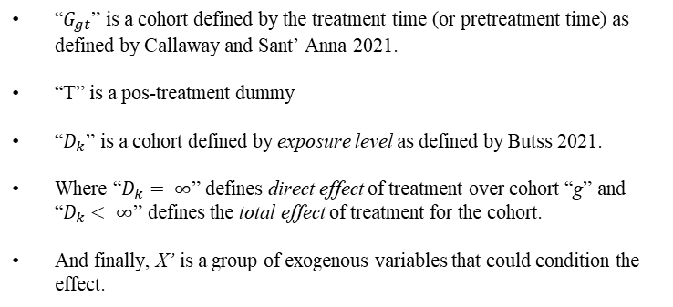
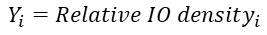
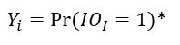
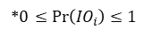
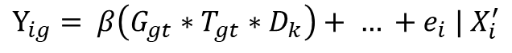
Empirical strategy
I. Probabilistic approach
$Y_{i}=Pr⁡(IO_{I}=1)$*
Unit of analysis is a standardized gomphacil unit.
Treatment and controls are defined by intersection between hexagons centroids and legalization polygons
Probability of each period is either binary, or define by a probabilistic value form a supervise classification model per year
Exposure level are defined by contiguity and distance between centroids.
10 %
40 %
25 %
20 %
Dif Dif with multiple time periods and spatial spill overs.
8 %
10 %
→
10 %
25 %
4 %
8 %
8 %
4 %
10 %
10 %
4 %
4 %
t
t+1
$$Y_{ig}= β\left(G_{gt}∗T_{gt}∗D_{k}\right)+ … +e_{i} | X_{i}^{′}$$
Treated unit in time t+1
Untreated unit in time t;t+1
“$G_{gt}$” is a cohort defined by the treatment time (or pretreatment time) as defined by Callaway and Sant’ Anna 2021.
“T” is a pos-treatment dummy
“$D_{k}$” is a cohort defined by exposure level as defined by Butss 2021.
Where “$D_{k}= ∞$” defines direct effect of treatment over cohort “g” and “$D_{k}< ∞$” defines the total effect of treatment for the cohort.
And finally, X’ is a group of exogenous variables that could condition the effect.
II. Continuous approach
$$Y_{i}=Relative IO density_{i}$$
Unit of analysis is the legalization polygon and its predefined buffers.
The outcome variable is either the number of informal ocupations (IO) or the relative density (IO_{i}/area_{i})
Exposure level are categorically defined by each buffer
Treated area (legalization polygon) in time t+1
Untreated area (buffer at ‘D’ distance) in time t;t+1
*$0≤Pr\left(IO_{i}\right)≤1$
Universidad del Rosario - Faculty of Economics
Guibor Camargo

Slide 21
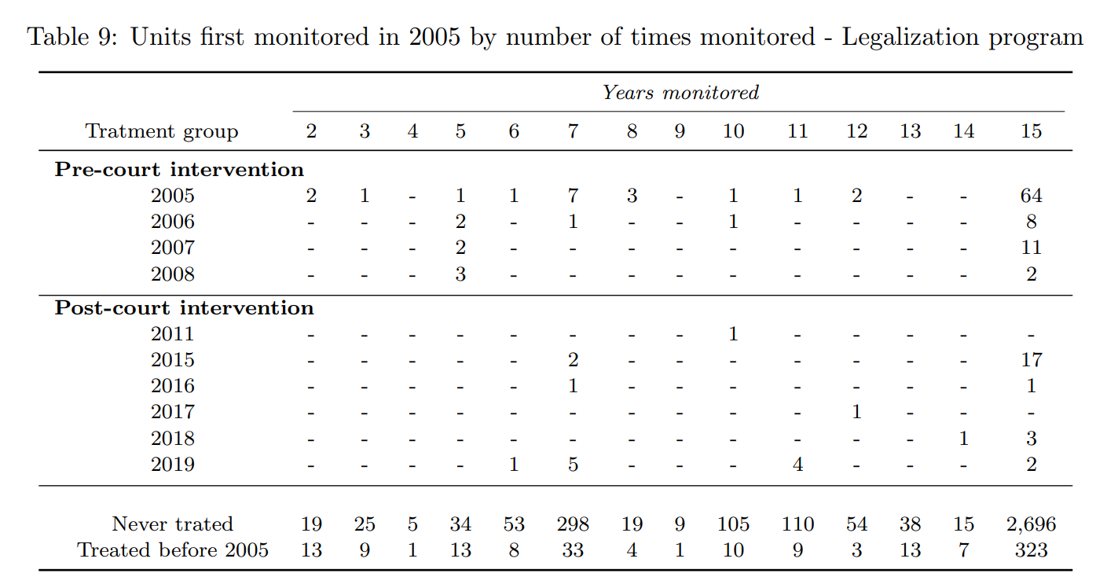
Results

Slide 22
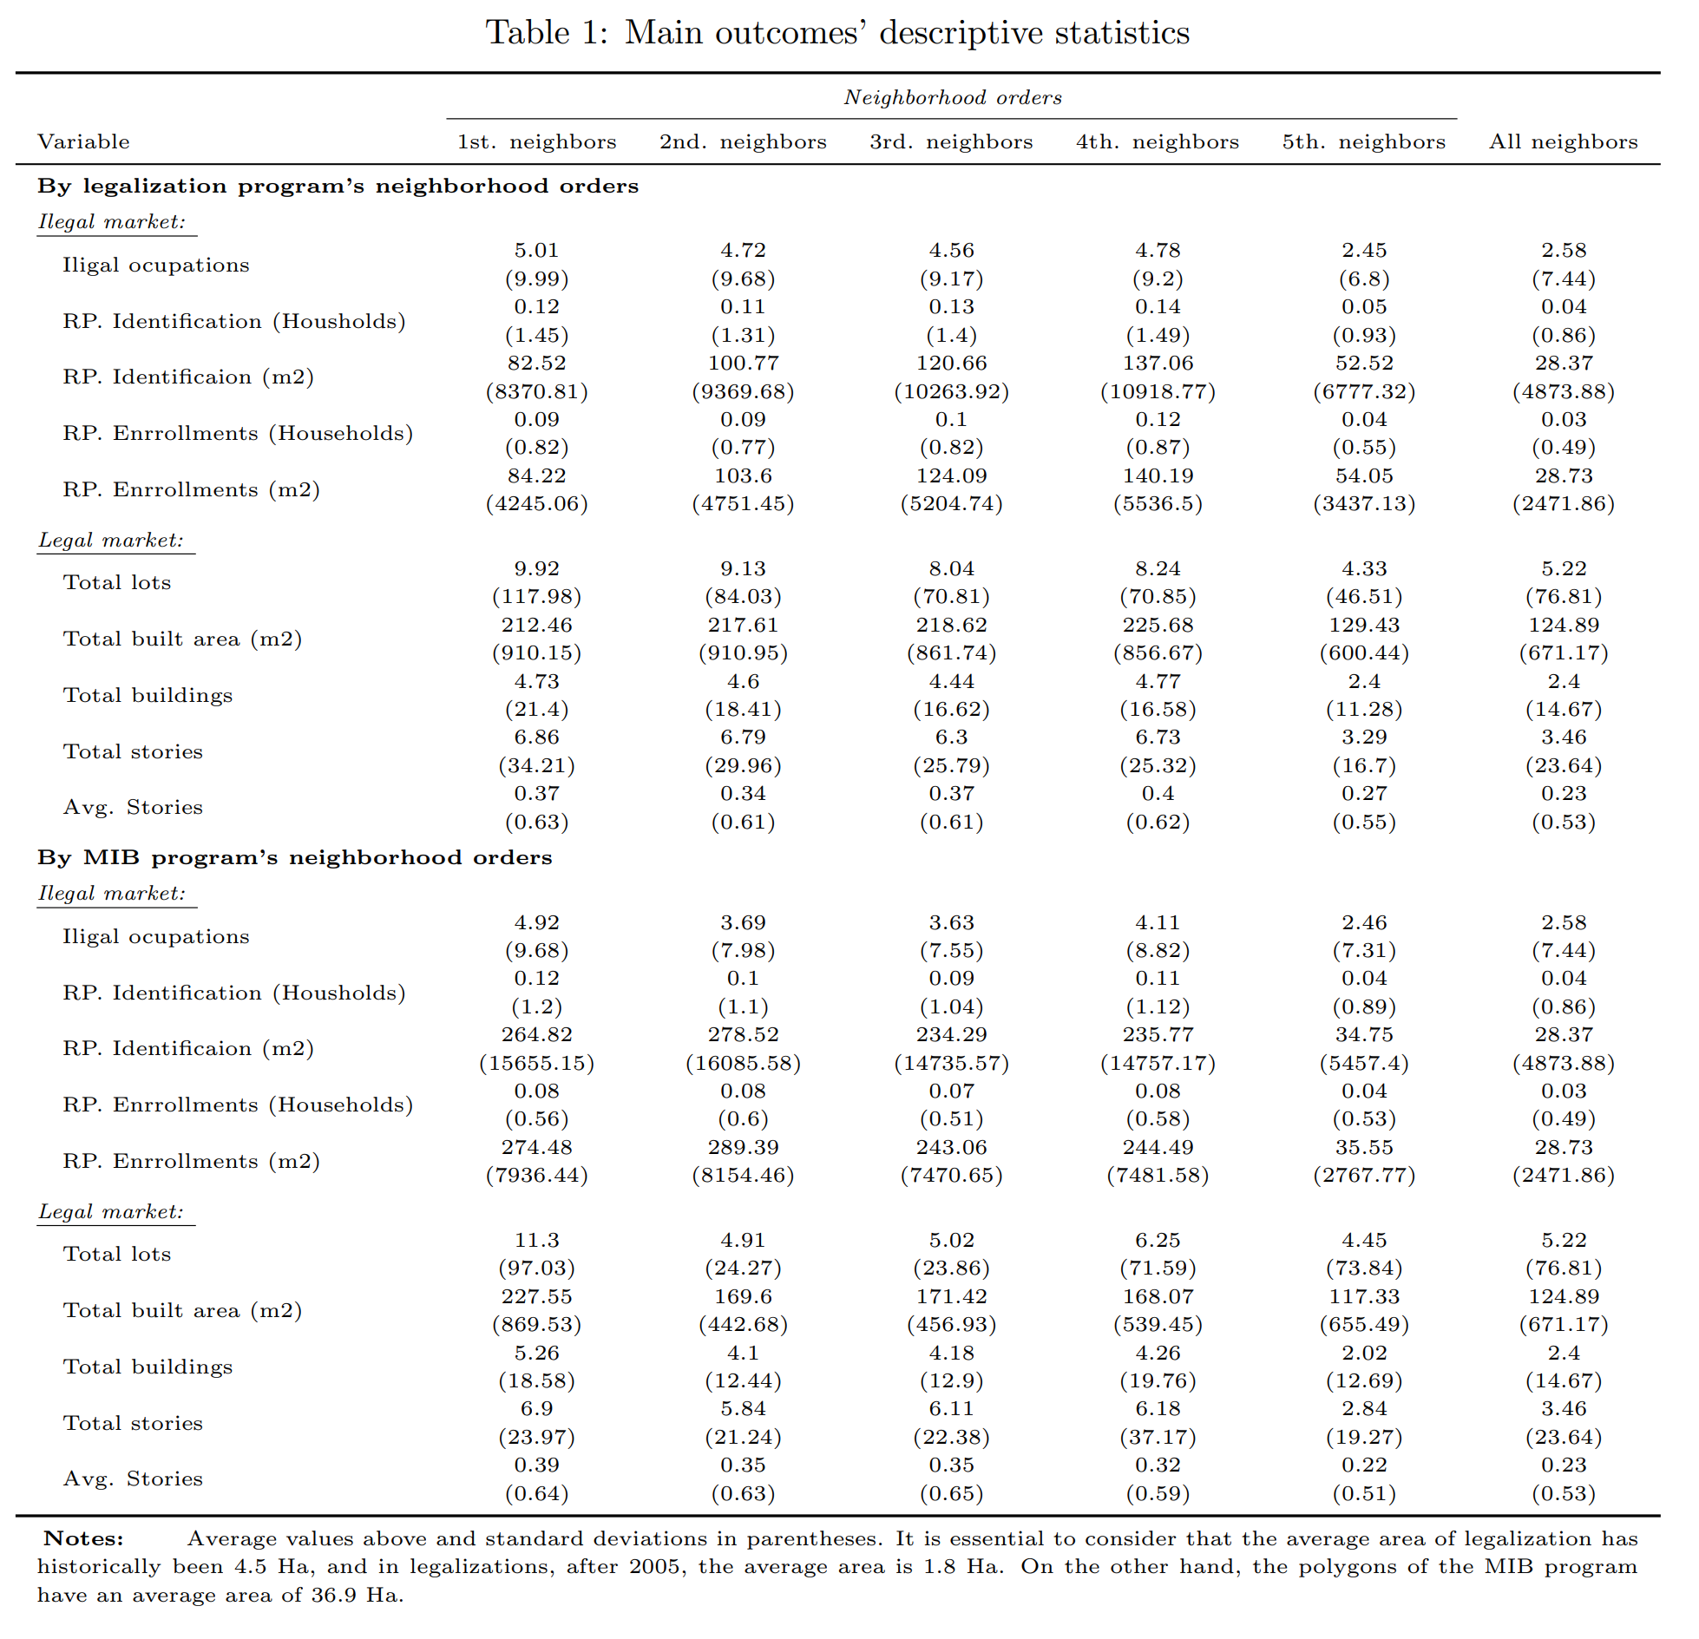
Descriptive statistics I
Universidad del Rosario - Faculty of Economics
Guibor Camargo

Slide 23
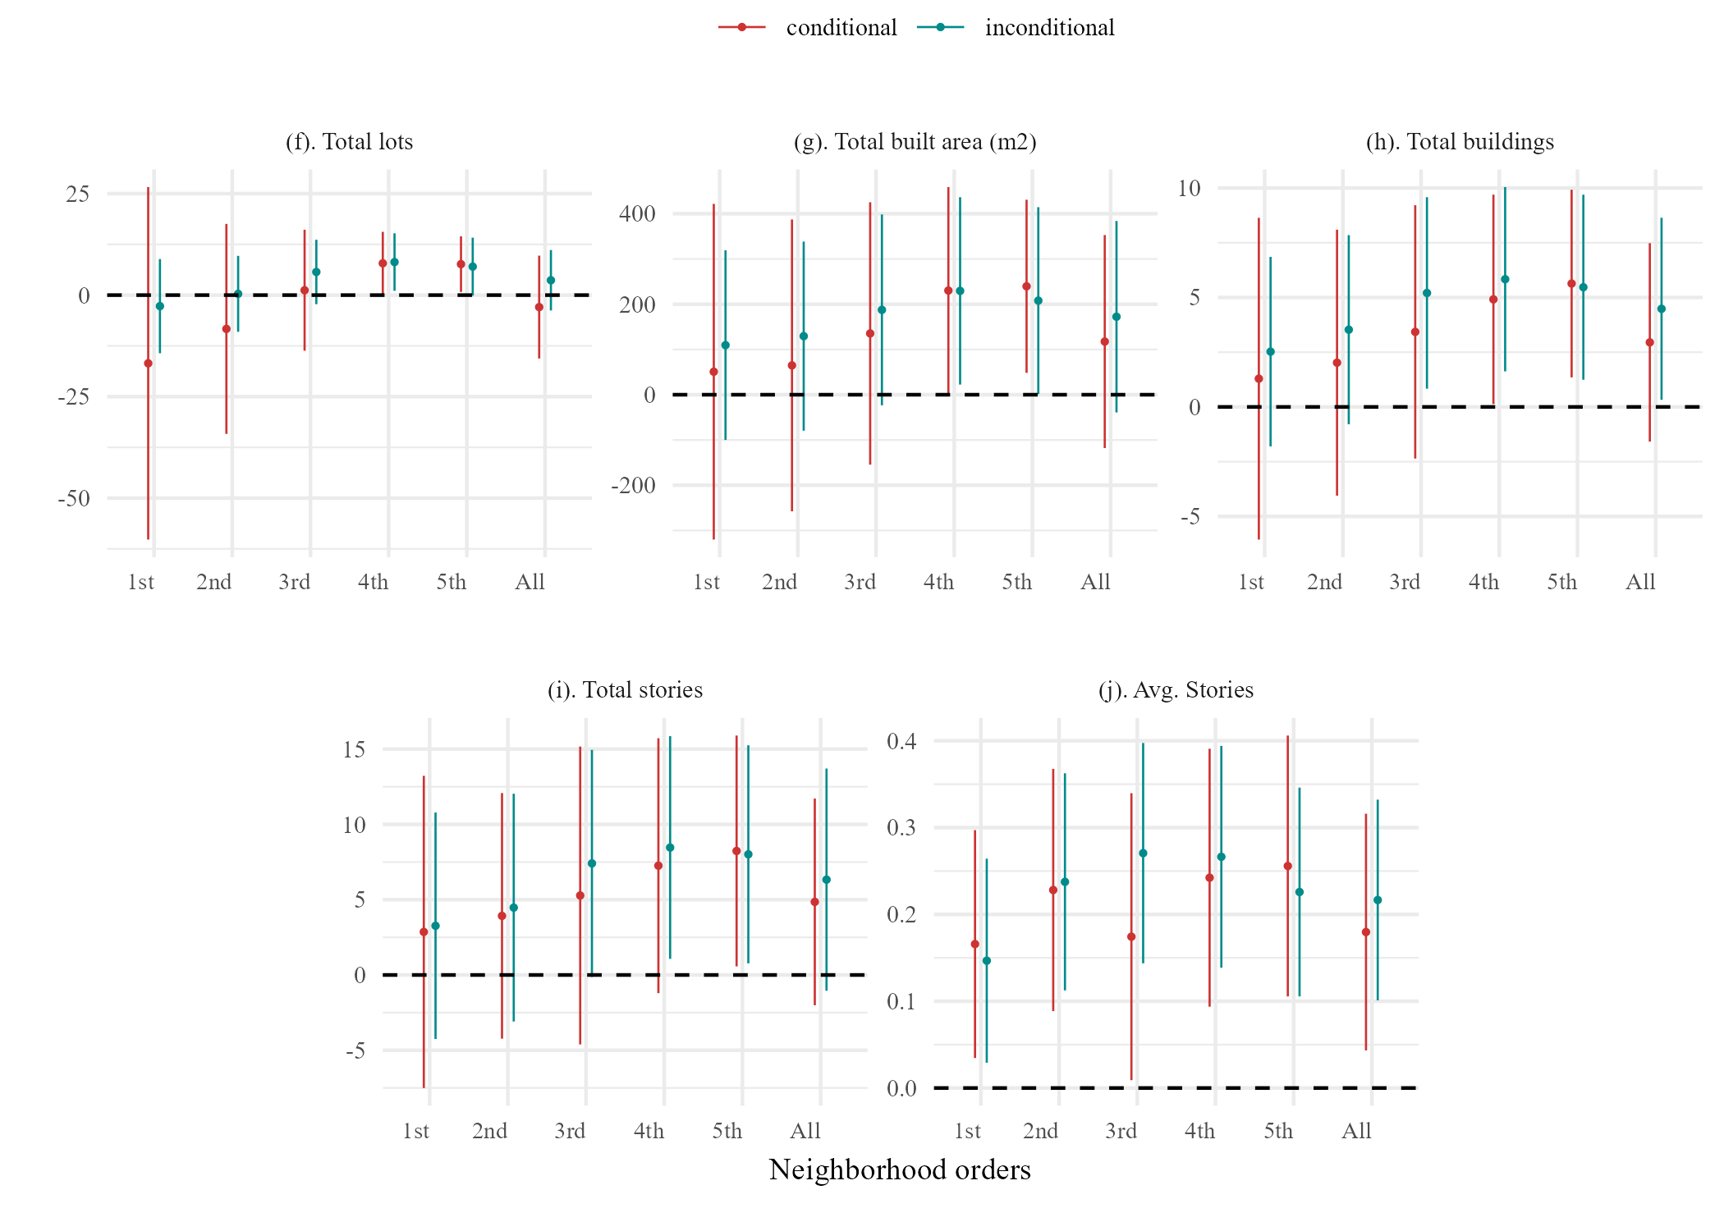
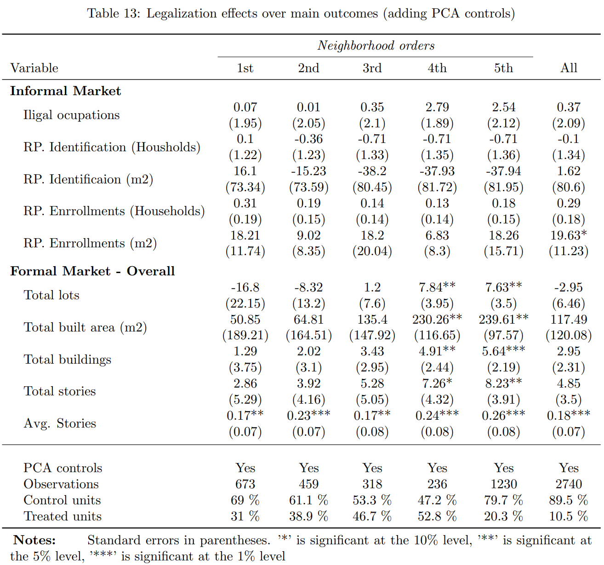
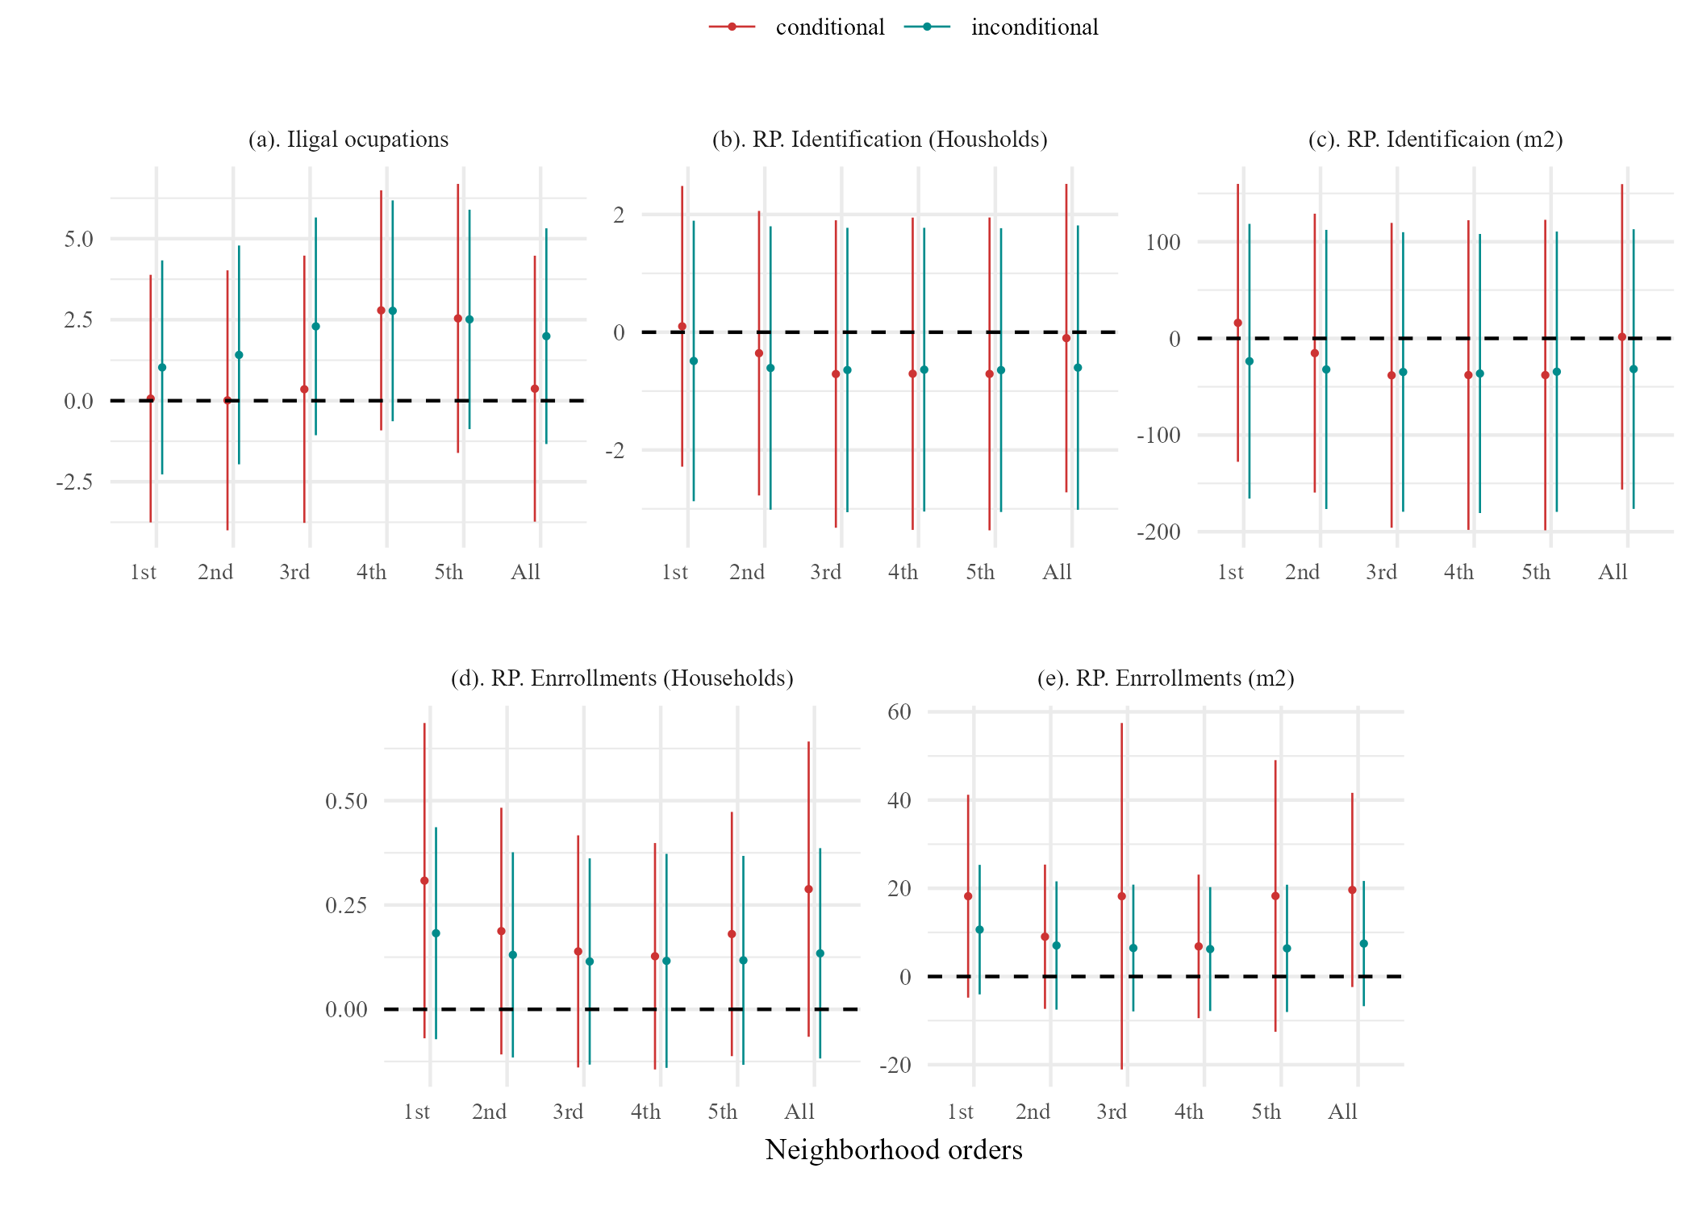
Legalization general effects
Universidad del Rosario - Faculty of Economics
Guibor Camargo

Slide 24
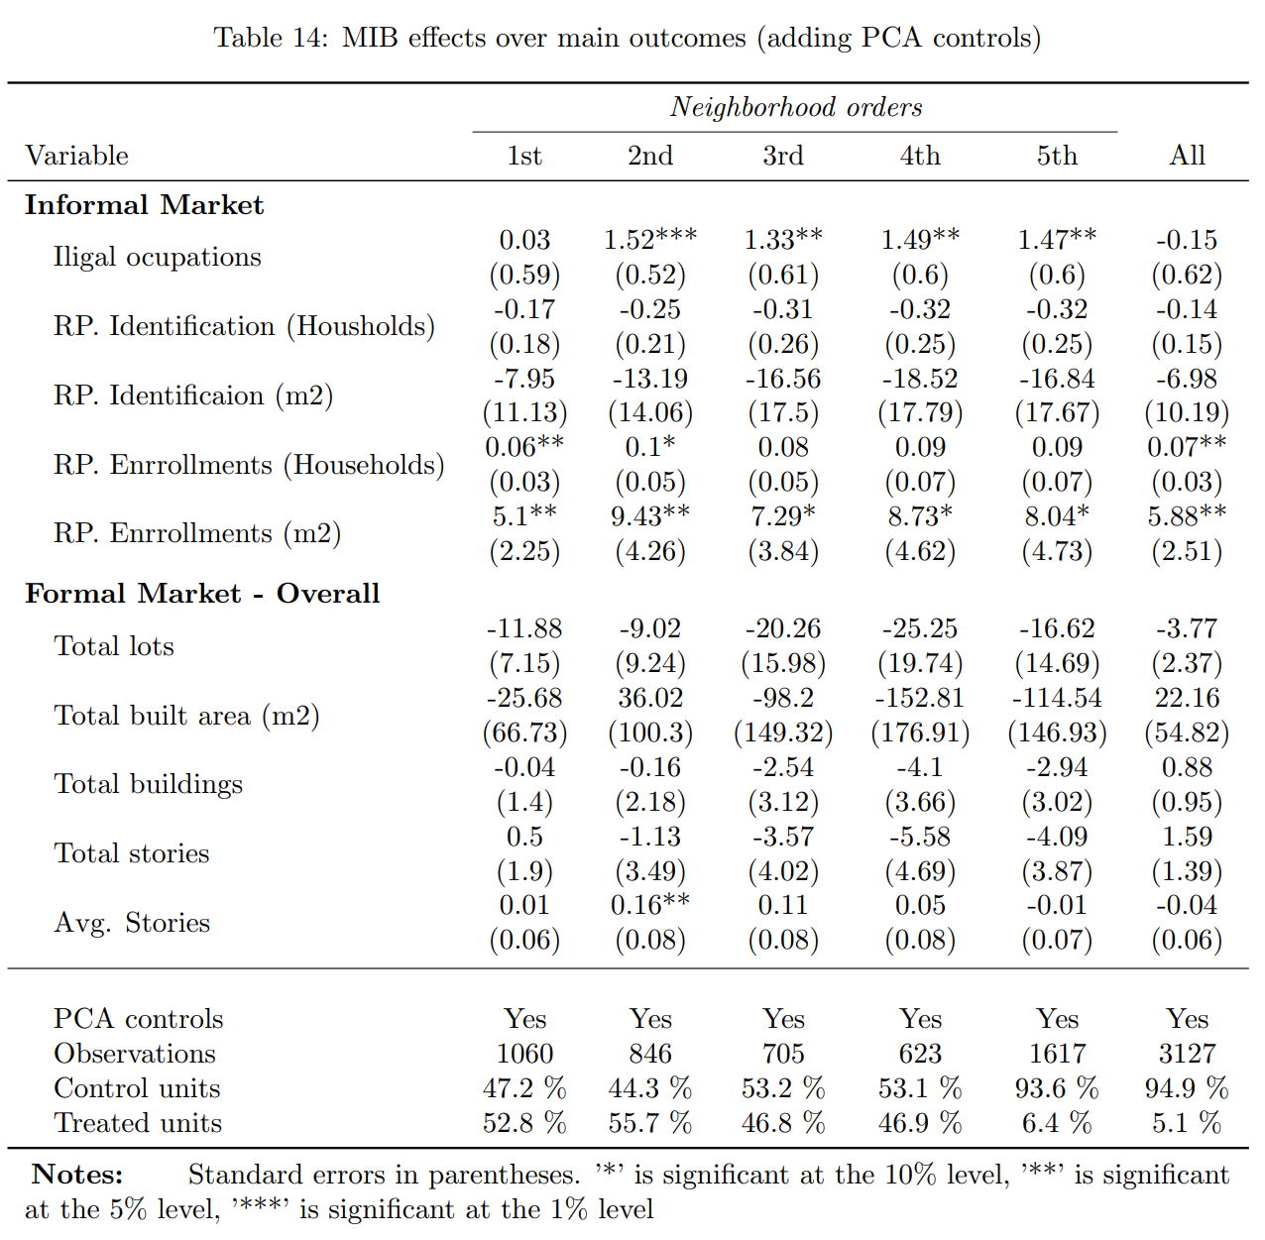
Legalization general effects
Universidad del Rosario - Faculty of Economics
Guibor Camargo

Slide 25
MIB general effects
Universidad del Rosario - Faculty of Economics
Guibor Camargo

Slide 26
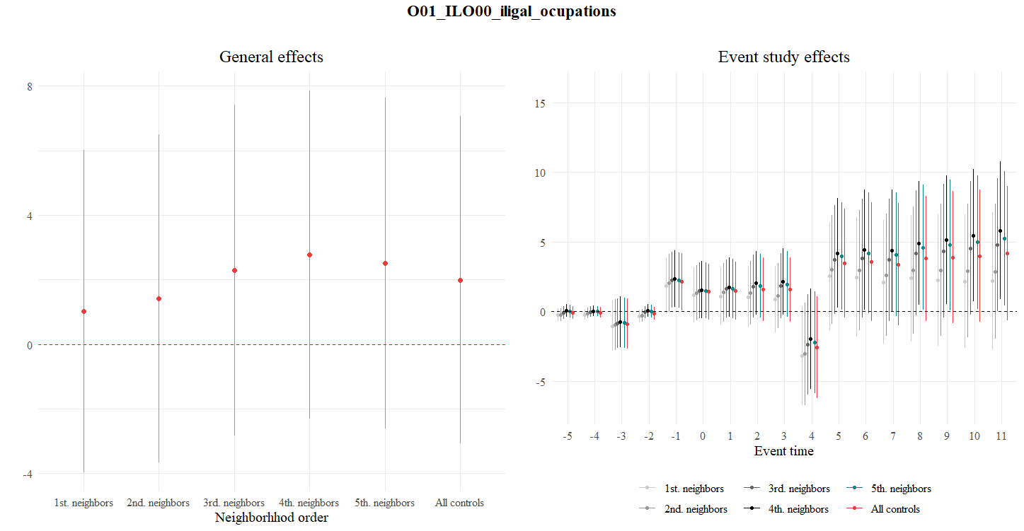
Example of general and event study plots
Universidad del Rosario - Faculty of Economics
Guibor Camargo

Slide 27
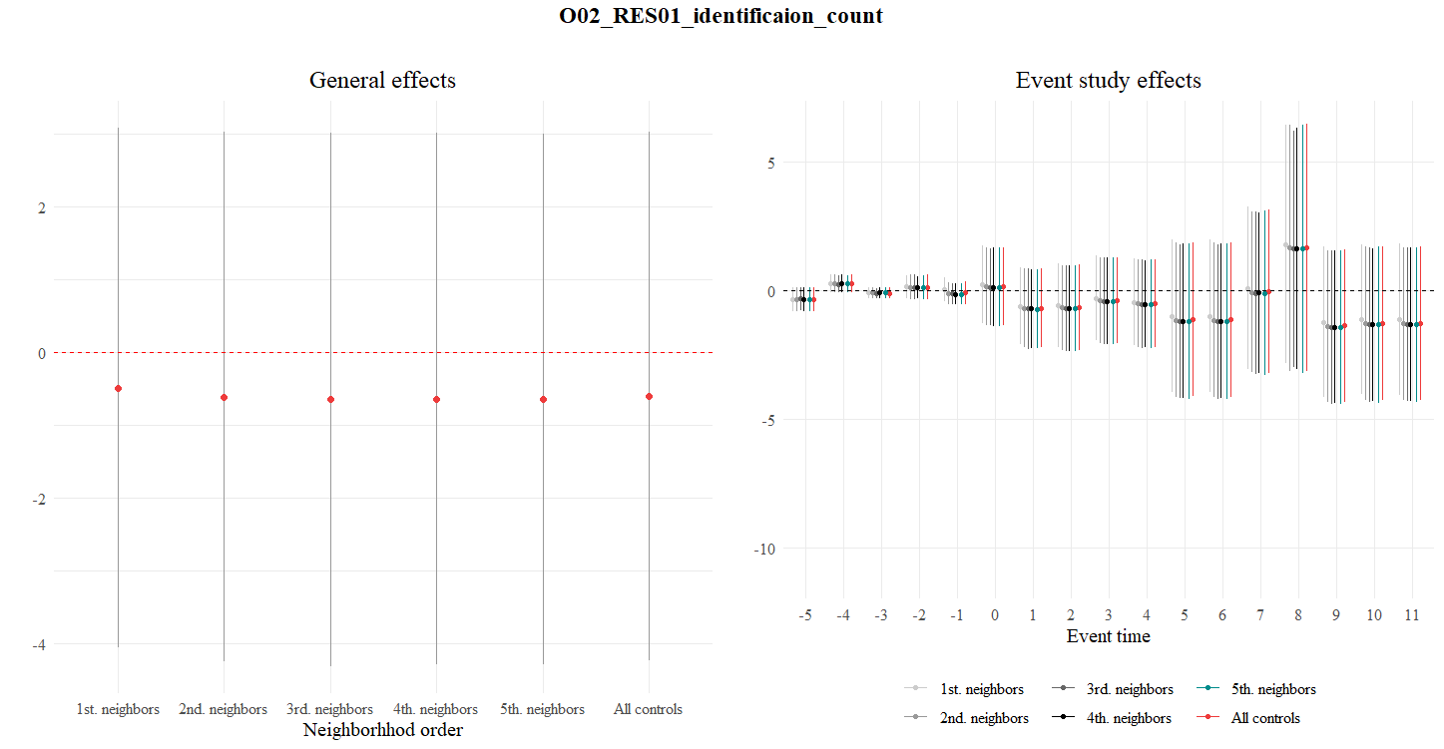

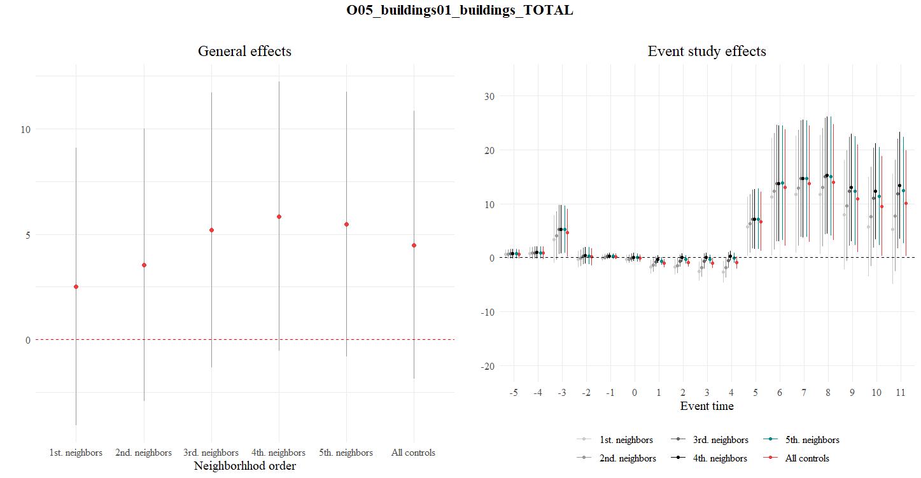
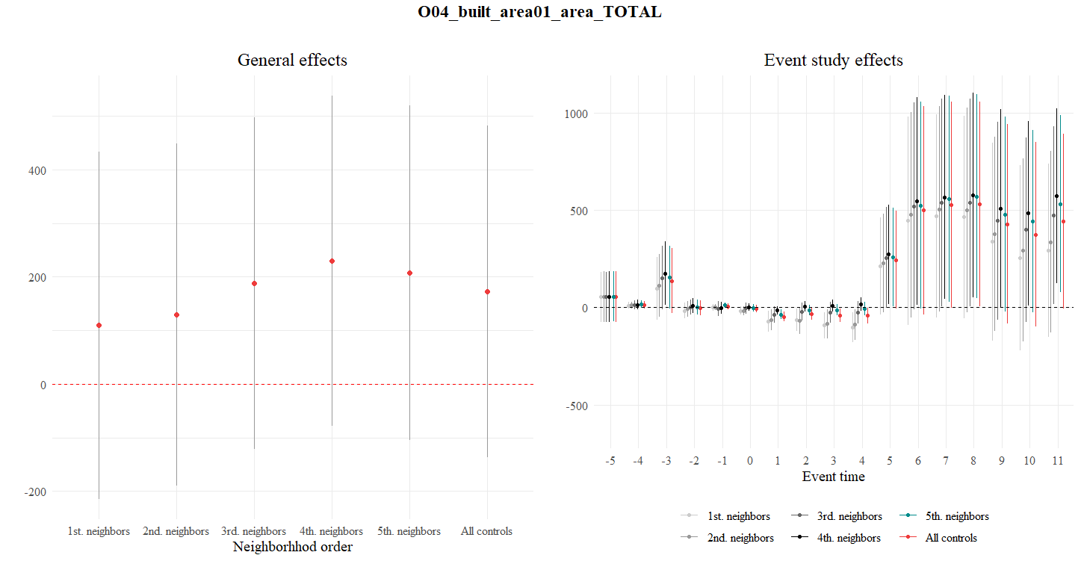
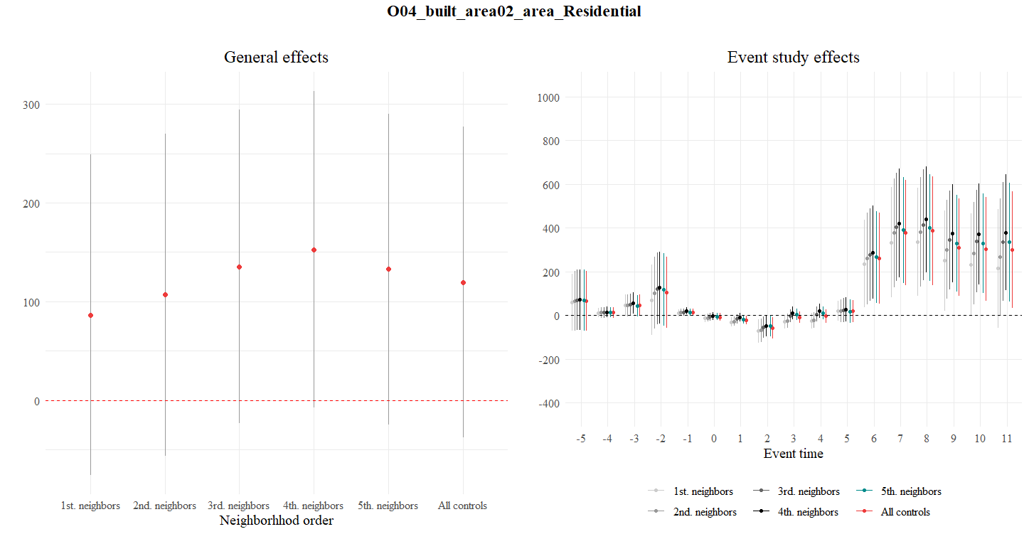
Example of general and event study plots
Universidad del Rosario - Faculty of Economics
Guibor Camargo

Slide 28
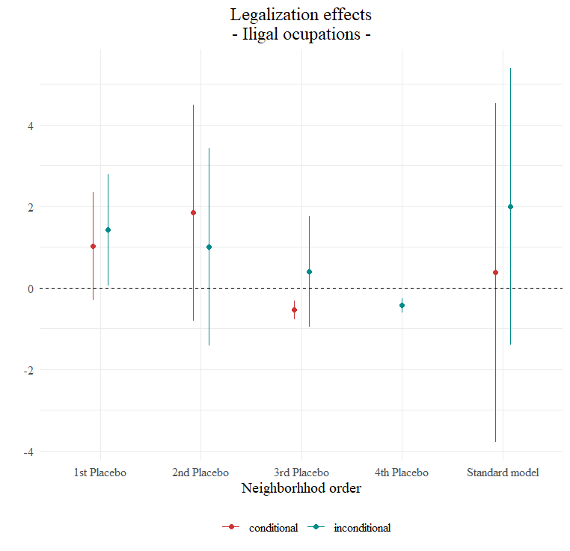
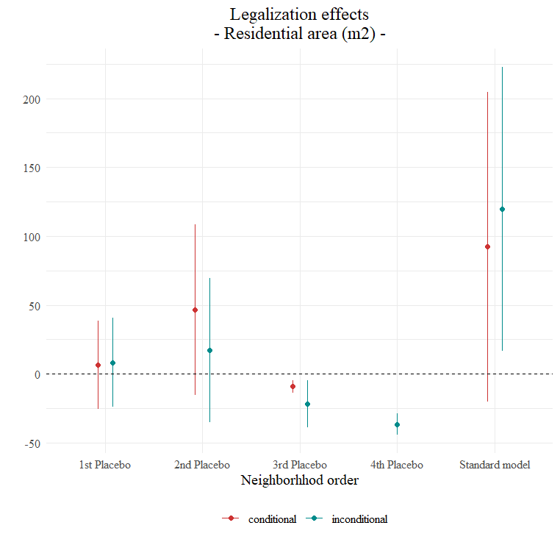
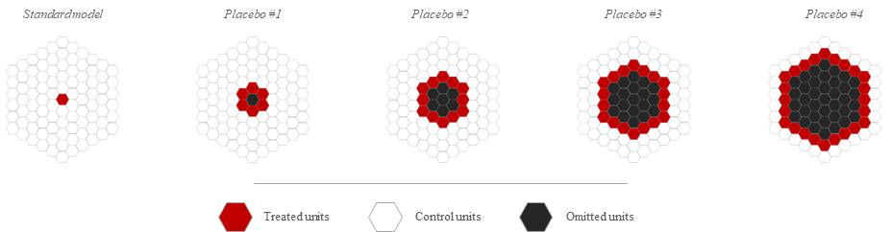
Example of Placebo plots
Universidad del Rosario - Faculty of Economics
Guibor Camargo

Slide 29
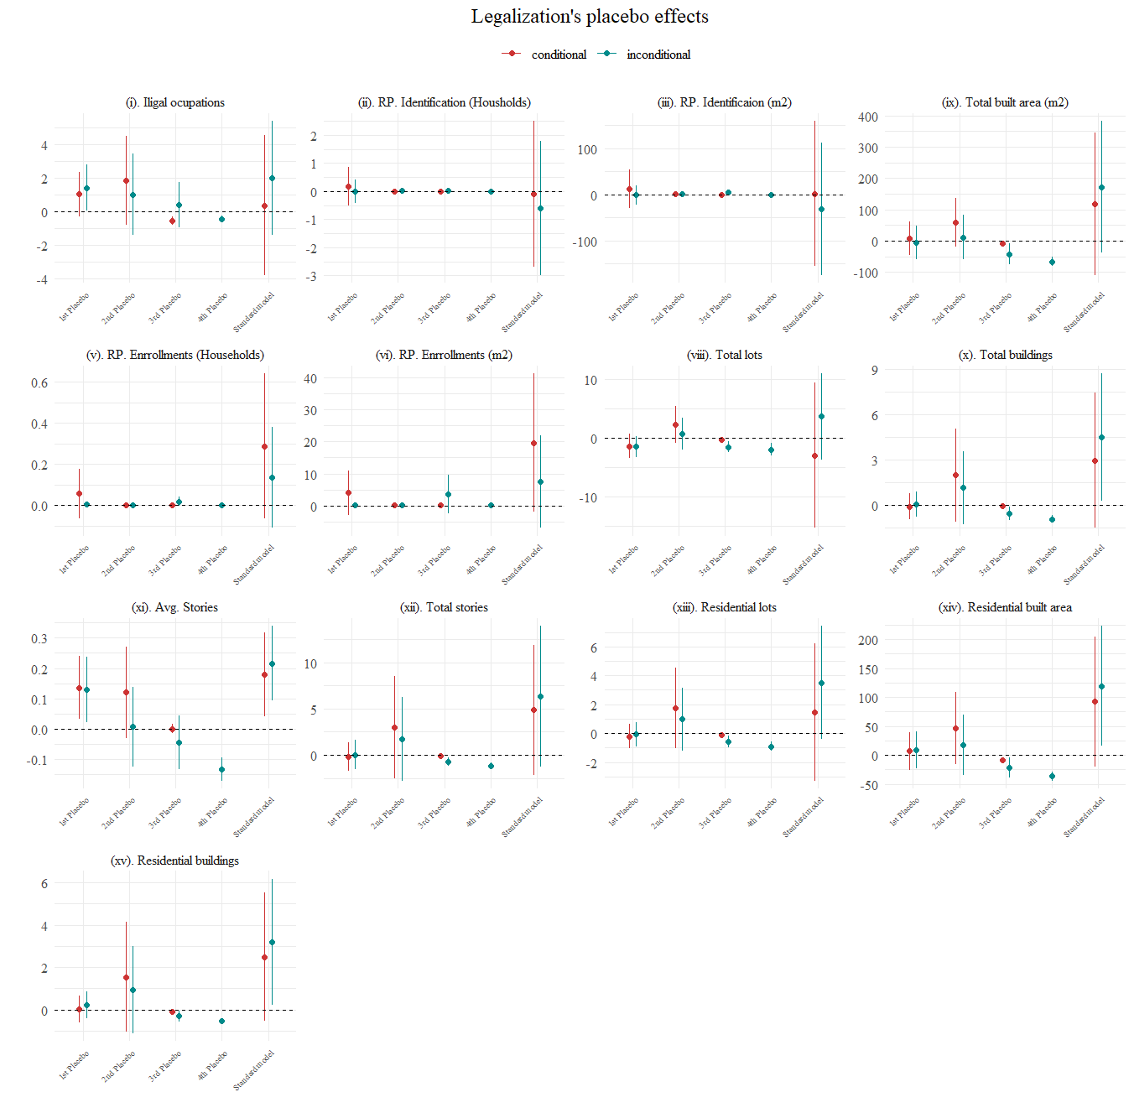
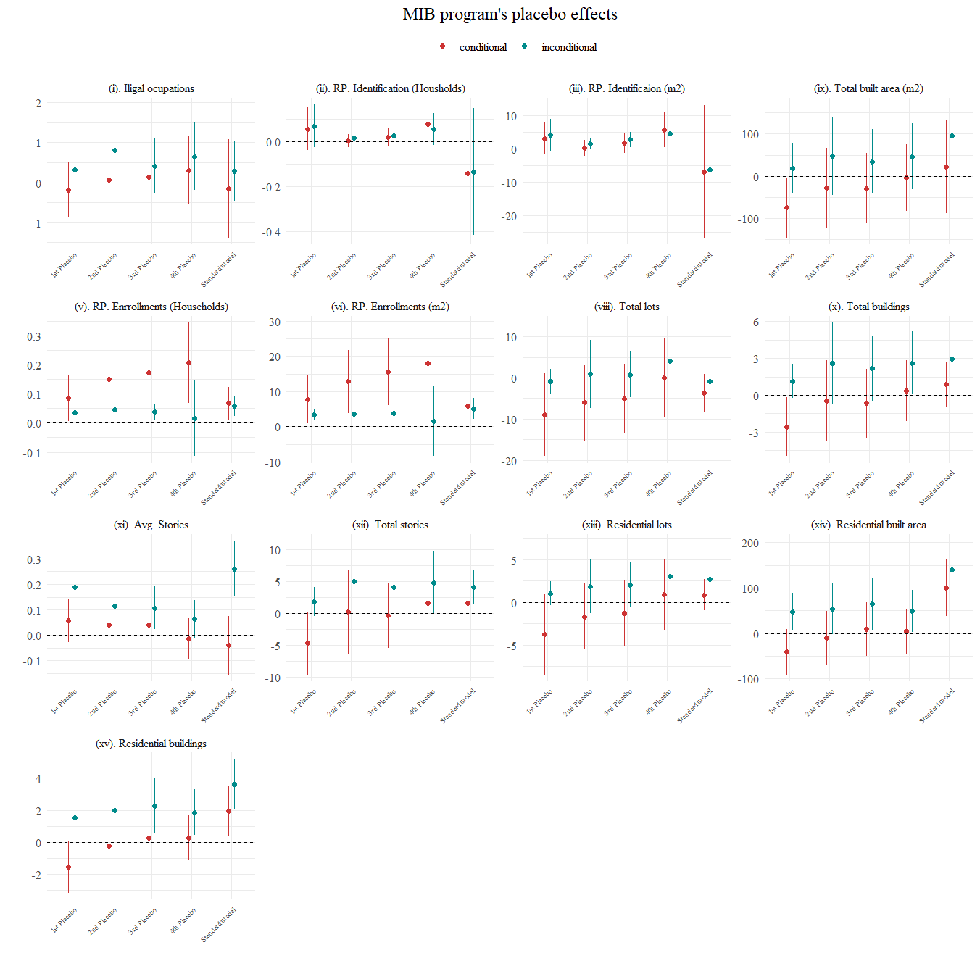
Example of Placebo plots
Placebos’ structure
Placebo #1
Placebo #2
Placebo #3
Placebo #4
Standard model
Treated units
Control units
Omitted units
Universidad del Rosario - Faculty of Economics
Guibor Camargo

Slide 30
Empirical strategy
$$ATT_{1}…$$
$$ATT_{2}…$$
$$ATT_{1}…$$
$$ATT_{2}…$$
i =1
W = 0.06
i =1
i =2
W = 0.12
i =2
Distancia (W)
Distancia (W)
i =3
W = 0.25
i =3
i =4
W = 0.50
i =4
i =5
T = -2
T = -1
T = 0
T = 1
T = 2
T = 3
T = 4
i =5
2010
2011
2012
2013
2014
2015
2016
2010
2011
2012
2013
2014
2015
2016
Año previo a ser legalizado (C = 1)
Buffer de x radio
Año de legalización (T = 1 / T = 0)
Año después de legalizado (T = 1 / T = 1+t)
Universidad del Rosario - Faculty of Economics
Guibor Camargo

Slide 31
Empirical strategy
i =1
i =2
$$ATT…$$
Distancia (W)
i =3
i =1
W = 0.06
i =4
i =2
W = 0.12
Distancia (W)
i =5
i =3
W = 0.25
2010
2011
2012
2013
2014
2015
2016
i =4
$$ATT…$$
W = 0.50
i =5
T = -2
T = -1
T = 0
T = 1
T = 2
T = 3
T = 4
$$ITT…$$
2010
2011
2012
2013
2014
2015
2016
i =1
i =2
Año previo a ser legalizado (C = 1)
Año de inicio del proceso de legalización
Distancia (W)
i =3
Año de legalización (T = 1 / T = 0)
Año entre el aviso y la ejecución
i =4
Año después de legalizado (T = 1 / T = 1+t)
i =5
2010
2011
2012
2013
2014
2015
2016
Universidad del Rosario - Faculty of Economics
Guibor Camargo

Slide 32
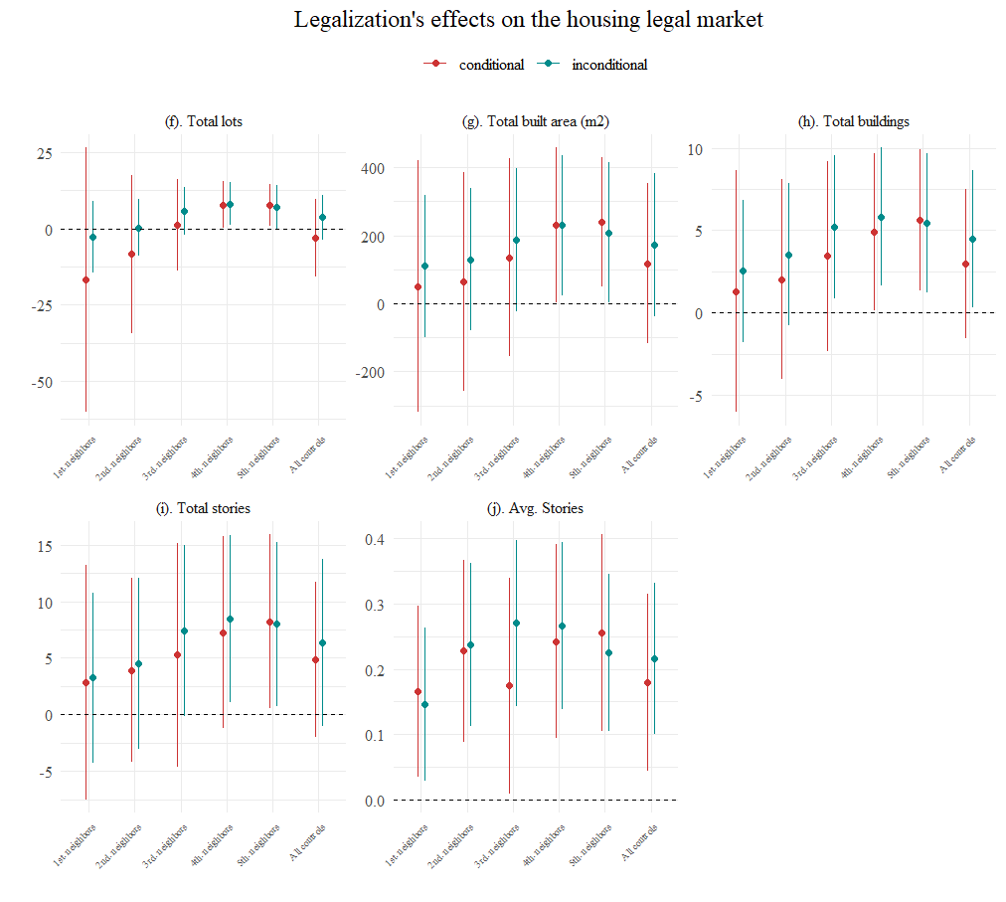
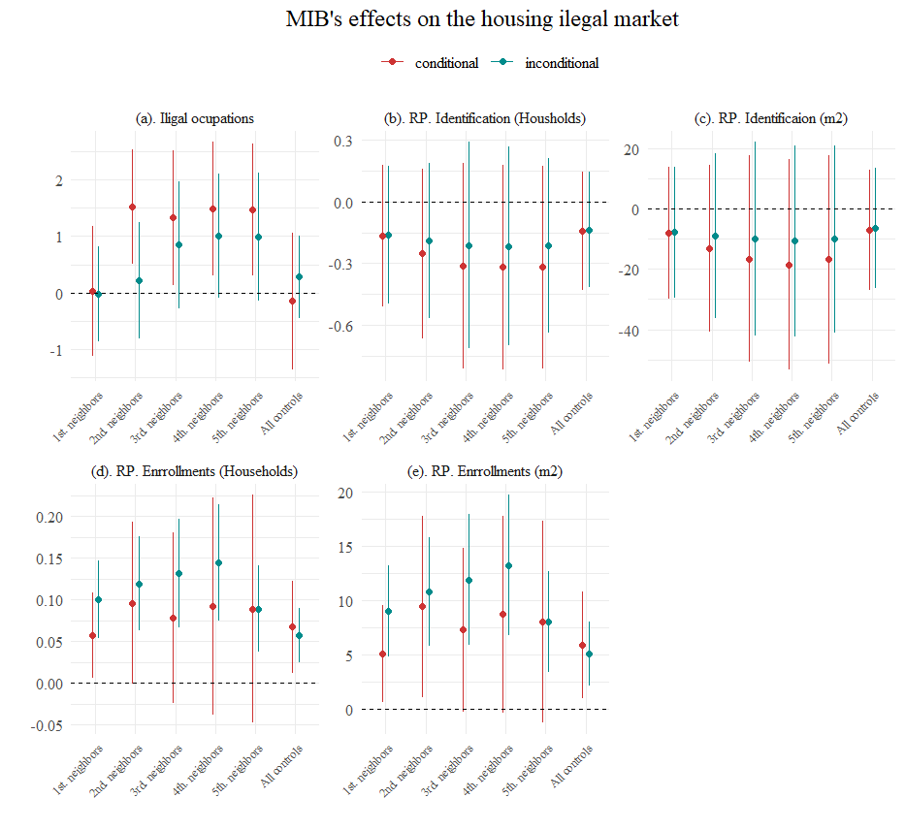
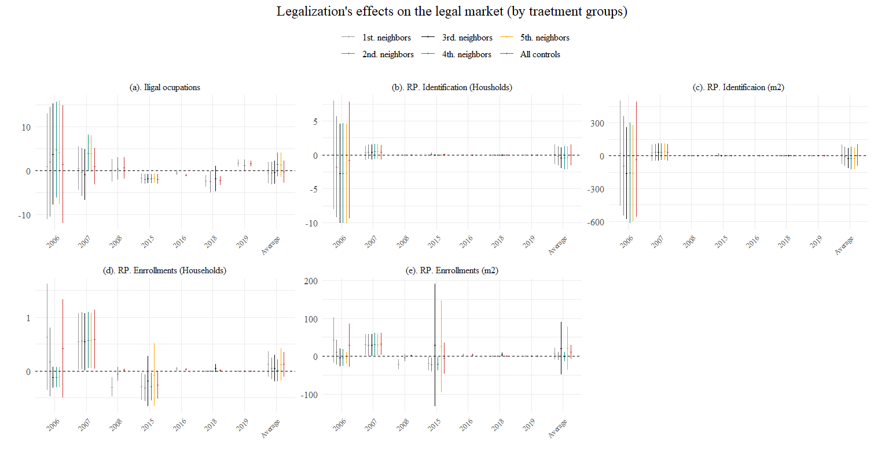
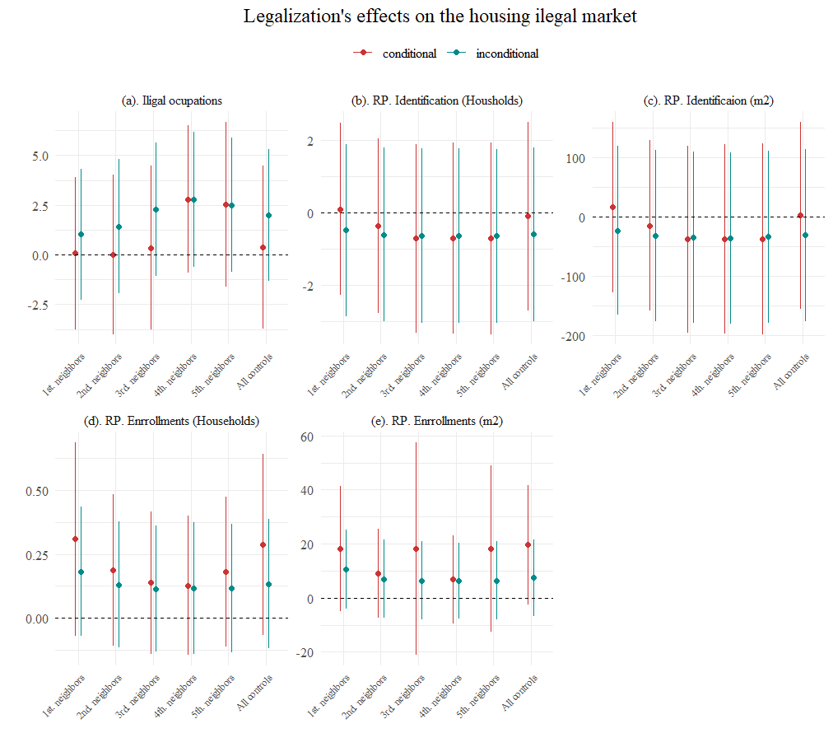
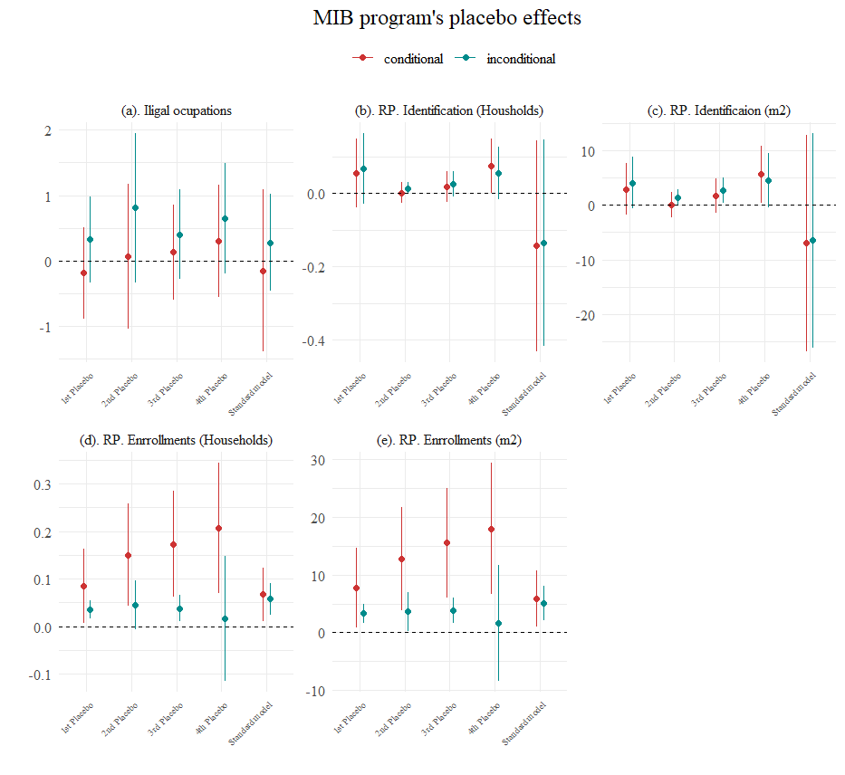
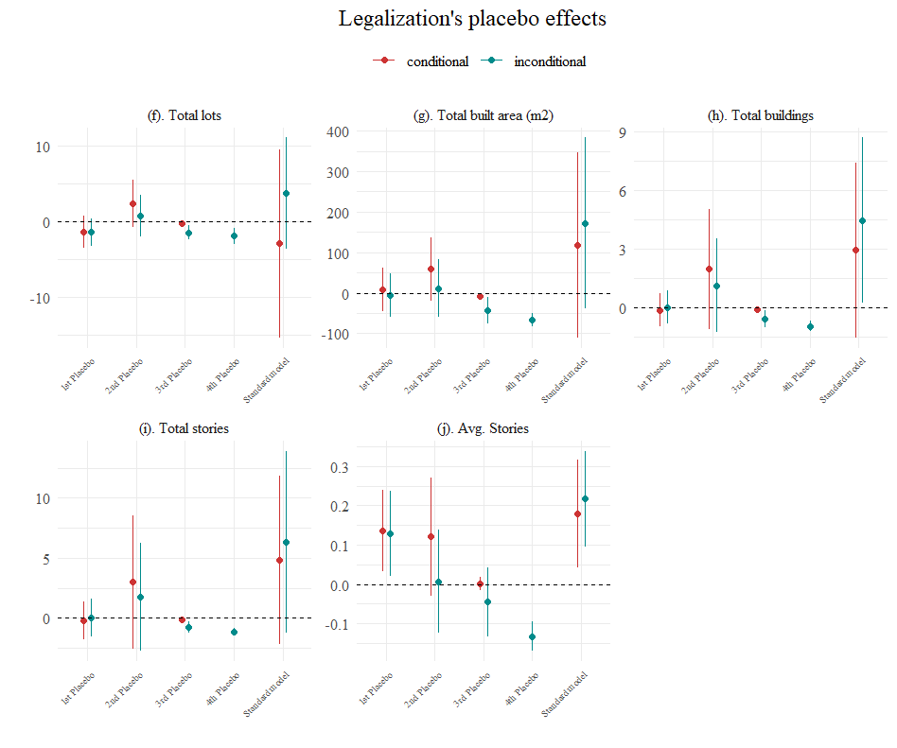

Slide 33
Violación de SUTVA, geográfica y macro-teporalmente
Anticipación del tratamiento
No hay unidades “never-tretead”
Perdida del poder de comparación con el tiempo
Sin información de dependientes y covariables de la mayor parte del programa
Endogeneidad entre el tratamiento y la variable de efecto
Relación entre las variables dependientes principales y otros programas similares
Cambio en las condiciones del tratamiento (agua como derecho)
Sesgos de error de medición
i =1
i =2
i =3
i =4
i =5
2010
2011
2012
2013
2014
2015
2016
Polígono de legalización legalizado
Polígono de legalización aun no legalizado
Legalizado

